Slide 1
Regrowth Assessment Protocol for a study of peyote harvesting
Cactus Conservation Institute’s signature study on the impact of peyote harvesting is the only longitudinal study ever conducted on this species.
This study is ongoing and new data will be reported as CCI has resources and as long as the plants themselves remain in the field to study.
These images were gathered in the 2009-2010 time period at the beginning of the study.
Copyright Cactus Conservation Institute, 2009-2020. All rights reserved.

Slide 2
Site 101 - 2009
Regrowth on #101

Slide 3
Site 101 - 2010
Regrowth on #101

Slide 4
Site 101 - 2010
Regrowth on #101

Slide 5
Site 102 - 2009

Slide 6
Site 102 - 2009
Regrowth on #102

Slide 7
Site 102* - 2010
*No sign of 102 other than its tag

Slide 8
Site 103 - 2009

Slide 9
Site 103 - 2009

Slide 10
Site 103 - 2009
Regrowth on #103

Slide 11
Site 103* - 2010
*Regrowth on 103

Slide 12
Site 104 - 2010
Regrowth on #104

Slide 13
Site 104 - 2010
Regrowth on #104

Slide 14
Site 104 - 2010
Regrowth on #104

Slide 15
Site 105 - 2010
We found the tag from #105. Found thanks to our new metal detector but there was no trace of our subject. We did not find much since we thought this one was dead on the first return visit.

Slide 16
Site 106 - 2009
Regrowth on #106

Slide 17
Site 106 - 2010
This shows two original heads – not regrowth

Slide 18
Site 106 - 2010
This is an original head – not regrowth

Slide 19
Site 106 - 2010
This is an original head – not regrowth

Slide 20
Site 106 - 2010
Site where the original head was removed – notice the new regrowth.

Slide 21
Site 106 - 2010
Closer view of regrowth.

Slide 22
Site 106 - 2010
Closer view of regrowth.

Slide 23
Site 107 - 2009
Regrowth on #107

Slide 24
Site 107 - 2010
#107 has apparently died. Decomposed root could still be located with a finger.

Slide 25
Site 108 - 2009
Regrowth on #108

Slide 26
Site 108 - 2010
Regrowth on #108

Slide 27
Site 108 - 2010
Regrowth on #108

Slide 28
Site 109 - 2010
Regrowth on #109

Slide 29
Site 109 - 2010
Regrowth on #109

Slide 30
Site 109 - 2010
Regrowth on #109

Slide 31
Site 110 - 2010
Regrowth on #110

Slide 32
Site 111 - 2010
Regrowth on #111

Slide 33
Site 112 - 2009
Regrowth on #112

Slide 34
Site 112 - 2010
Regrowth on #112

Slide 35
Site 113 - 2009
Regrowth on #113

Slide 36
Site 113 - 2010
This was #113. Dead tissue from the head that was cut in 2008.

Slide 37
Site 114 - 2009
Regrowth on #114

Slide 38
Site 114 - 2010
Regrowth on #114.

Slide 39
Site 114 - 2010
Regrowth on #114.

Slide 40
Site 114 - 2010
Regrowth on #114.

Slide 41
Site 115 - 2009
Regrowth on #115

Slide 42
Site 115 - 2010
At least the tag for #115 is still there. This one appeared to be dead on our first return trip.

Slide 43
Site 116 - 2009

Slide 44
Site 116 – 2010
Regrowth on #116

Slide 45
Site 117 - 2009
Regrowth on #117

Slide 46
Site 117 - 2010
Regrowth on #117

Slide 47
Site 117 - 2010
Regrowth on #117

Slide 48
Site 117 - 2016
There was no apparent regrowth on #117. However, this loose crown was noticed a short distance from it.

Slide 49
Site 118 - 2009
Regrowth on #118

Slide 50
Site 118 - 2010
Regrowth on #118

Slide 51
Site 119 - 2009
Regrowth on #119

Slide 52
Site 119 - 2009
Regrowth on #119

Slide 53
Site 119 - 2010
Regrowth on #119

Slide 54
Site 120 - 2010
Regrowth on #120

Slide 55
Site 120 - 2010
Regrowth on #120

Slide 56
Site 121 - 2009
Regrowth on #121

Slide 57
Site 121 - 2010
Regrowth on #121

Slide 58
Site 122 - 2010
Regrowth on #122

Slide 59
Site 123 - 2010
Regrowth on #123

Slide 60
Site 123 - 2010
Regrowth on #123

Slide 61
Site 123 - 2010
Regrowth on #123

Slide 62
Site 124 - 2009
Regrowth on #121

Slide 63
Site 124 - 2010
Regrowth on #124

Slide 64
Site 125 - 2009
Regrowth on #125

Slide 65
Site 125 - 2009

Slide 66
Site 125 - 2010
Regrowth on #125

Slide 67
Site 125 - 2010
Regrowth on #125

Slide 68
Site 125 - 2010
Regrowth on #125

Slide 69
Site 125 - 2010
Regrowth on #125

Slide 70
Site 126 - 2010
Regrowth on #126

Slide 71
Site 126 - 2010
Regrowth on #126

Slide 72
Site 126 - 2010
Regrowth on #126

Slide 73
Site 127 - 2009
Regrowth on #127

Slide 74
Site 127 - 2010
Regrowth on #127

Slide 75
Site 127 - 2010
Regrowth on #127

Slide 76
Site 128 - 2009
Regrowth on #128

Slide 77
Site 128 - 2010
Regrowth on #128

Slide 78
Site 128 - 2010
Regrowth on #128

Slide 79
Site 128 - 2010
Regrowth on #128

Slide 80
Site 129 - 2009
Regrowth on #129

Slide 81
Site 129 - 2010

Slide 82
Site 129 - 2010
Regrowth on #129

Slide 83
Site 130 - 2009
Regrowth on #130

Slide 84
Site 130 - 2010
Regrowth on #130
The big head looked large for two years of regrowth so we carefully took a closer look. Notice that it is regrowth resulting from the original apical meristem being missed when the Site was cut.

Slide 85
Site 130 - 2010
Regrowth on #130
.

Slide 86
Site 130 - 2010
Regrowth on #130
.

Slide 87
Site 130 - 2010
Regrowth on #130
.

Slide 88
Site 130 - 2010
Regrowth on #130
.

Slide 89
Site 130 - 2010
Regrowth on #130
.

Slide 90
Site 130 - 2010
Regrowth on #130
.

Slide 91
Site 130 - 2010
Regrowth on #130
.

Slide 92
Site 130 - 2010
Regrowth on #130
.

Slide 93
Site 131 - 2009
Regrowth on #131

Slide 94
Site 131 - 2010
Regrowth on #131
Another question was resolved. We had some questions about this Site and returned on the 8th for another look. This nearby Site looked suspiciously like regrowth so we carefully took another look and discovered the original cut Site (see subsequent photos).

Slide 95
Site 131 - 2010
Regrowth on #131

Slide 96
Site 131 - 2010
Regrowth on #131

Slide 97
Site 131 - 2010
Regrowth on #131

Slide 98
Site 132 - 2009
Regrowth on #132

Slide 99
Site 132 - 2010
No sign of regrowth or #132

Slide 100
Site 133 - 2009
Regrowth on #133

Slide 101
Site 133 - 2010
Regrowth on #133

Slide 102
Site 134 - 2010
Regrowth on #134

Slide 103
Site 135 - 2009
Regrowth on #135

Slide 104
Site 135 - 2010

Slide 105
Site 135 – 2010

Slide 106
Site 136 - 2009
Regrowth on #136

Slide 107
Site 136 - 2010
Regrowth on #136

Slide 108
Site 136 - 2010
Regrowth on #136

Slide 109
Site 137 - 2009
Regrowth on #137

Slide 110
Site 137 - 2010
Regrowth on #137

Slide 111
Site 137 - 2010
Regrowth on #137

Slide 112
Site 138 - 2009
Regrowth on #138

Slide 113
Site 138 - 2010
Regrowth on #138

Slide 114
Site 138 - 2010
Regrowth on #138

Slide 115
Site 138 - 2010
Regrowth on #138

Slide 116
Site 139 - 2009

Slide 117
Site 139 - 2010
Regrowth on #139

Slide 118
Site 140 - 2009
Regrowth on #140

Slide 119
Site 140 - 2009
Regrowth on #140

Slide 120
Site 140 - 2010
Site on #140

Slide 121
Site 140 - 2010
Remains were excavated on 26-July-2010. Carcass is depicted below.

Slide 122
Site 141 - 2009
Regrowth on #141

Slide 123
Site 141 - 2010
Regrowth on #141

Slide 124
Site 142 - 2010
Regrowth on #142

Slide 125
Site 143 - 2010
Regrowth on #143

Slide 126
Site 143 - 2010
Regrowth on #143

Slide 127
Site 144 -2009
Regrowth on #144

Slide 128
Site 144 -2010
Regrowth on #144

Slide 129
Site 144 -2010
Regrowth on #144

Slide 130
Site 145 - 2009
Regrowth on #145

Slide 131
Site 145 - 2010
Regrowth on #145

Slide 132
Site 146 - 2009
Regrowth on #146

Slide 133
Site 146 - 2010
Regrowth on #146

Slide 134
Site 147 - 2009
Regrowth on #147

Slide 135
Site 147 - 2010
Regrowth on #147

Slide 136
Site 148 - 2009
Regrowth on #148

Slide 137
Site 148 - 2010
Regrowth on #148

Slide 138
Site 148 - 2010
Regrowth on #148

Slide 139
Site 149 - 2009

Slide 140
Site 149 - 2010
Regrowth on #149

Slide 141
Site 149 - 2010
Regrowth on #149

Slide 142
Site 150 - 2009
Regrowth on #150

Slide 143
Site 150 - 2010
Regrowth on #150

Slide 144
Site 150 - 2010
Regrowth on #150

Slide 145
Site 150 - 2010
Regrowth on #150

Slide 146
Control Site 151 - 2009

Slide 147
Control Site 151 - 2009

Slide 148
Control Site 151 - 2010
This area experienced a lot of hog activity since our last visit

Slide 149
Control Site 151 - 2010
This area experienced a lot of hog activity since our last visit

Slide 150
Control Site 151 - 2010
This area experienced a lot of hog activity since our last visit

Slide 151
Control Site 151 - 2010
This area experienced a lot of hog activity since our last visit

Slide 152
Control Site 151 - 2010
This area experienced a lot of hog activity since our last visit

Slide 153
Control Site 151 - 2010
This area experienced a lot of hog activity since our last visit

Slide 154
Control Site 151 - 2010
This area experienced a lot of hog activity since our last visit

Slide 155
Control Site 152 - 2009

Slide 156
Control Site 152 - 2010

Slide 157
Control Site 152 - 2010

Slide 158
Control Site 152 - 2010

Slide 159
Control Site 153 - 2009

Slide 160
Control Site 153 - 2010

Slide 161
Control Site 153 - 2010

Slide 162
Control Site 154 - 2009

Slide 163
Control Site 154 - 2009

Slide 164
Control Site 154 - 2009

Slide 165
Control Site 154 - 2009

Slide 166
Control Site 154 - 2010

Slide 167
Control Site 154 - 2010

Slide 168
Control Site 154 - 2010

Slide 169
Control Site 155 - 2009

Slide 170
Control Site 155 - 2010

Slide 171
Control Site 155 - 2010

Slide 172
Control Site 156 - 2009

Slide 173
Control Site 156 - 2010

Slide 174
Control Site 157 - 2009

Slide 175
Control Site 157 - 2010

Slide 176
Control Site 157 - 2010

Slide 177
Control Site 158 - 2009

Slide 178
Control Site 158 - 2010

Slide 179
Control Site 158 - 2010

Slide 180
Control Site 159 - 2009

Slide 181
Control Site 159 - 2010

Slide 182
Control Site 159 - 2010

Slide 183
Control Site 160 - 2009

Slide 184
Control Site 160 - 2010

Slide 185
Control Site 160 - 2010

Slide 186
Control Site 161 - 2009

Slide 187
Control Site 161 - 2010

Slide 188
Control Site 161 - 2010

Slide 189
Control Site 162 - 2009

Slide 190
Control Site 162 - 2010

Slide 191
Control Site 162 - 2010

Slide 192
Control Site 163 - 2009

Slide 193
Control Site 163 - 2009

Slide 194
Control Site 163 - 2010

Slide 195
Control Site 164 - 2009

Slide 196
Control Site 164 - 2010

Slide 197
Control Site 164 - 2010

Slide 198
Control Site 165 - 2009

Slide 199
Control Site 165 - 2010

Slide 200
Control Site 165 - 2010

Slide 201
Control Site 166 - 2009

Slide 202
Control Site 166 - 2010

Slide 203
Control Site 167 - 2009

Slide 204
Control Site 167 - 2010

Slide 205
Control Site 167 - 2010

Slide 206
Control Site 167 - 2010

Slide 207
Control Site 168 - 2009

Slide 208
Control Site 168 - 2009

Slide 209
Control Site 168 - 2010
Showing clear signs of disease in March 2010

Slide 210
Control Site 168 - 2010
Showing clear signs of disease in March 2010

Slide 211
Control Site 168 - 2010
Site had died and decayed by 26 July 2010 (carcass is depicted below)

Slide 212
Control Site 169 - 2009

Slide 213
Control Site 169 - 2010

Slide 214
Control Site 170 - 2009

Slide 215
Control Site 170 - 2010

Slide 216
Control Site 170 - 2010

Slide 217
Control Site 171 - 2009

Slide 218
Control Site 171 - 2010

Slide 219
Control Site 171 - 2010

Slide 220
Control Site 172* - 2009
*Probable ID; tag in photo is unclear

Slide 221
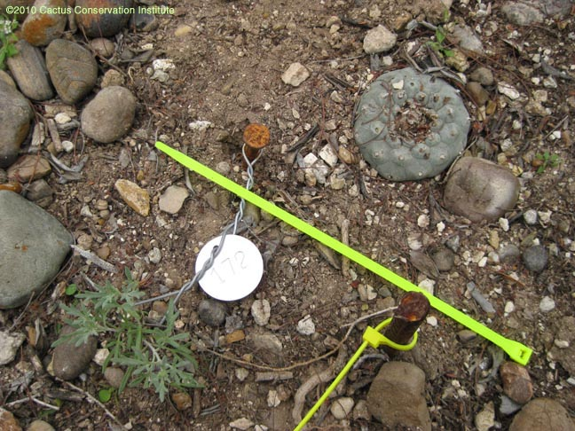
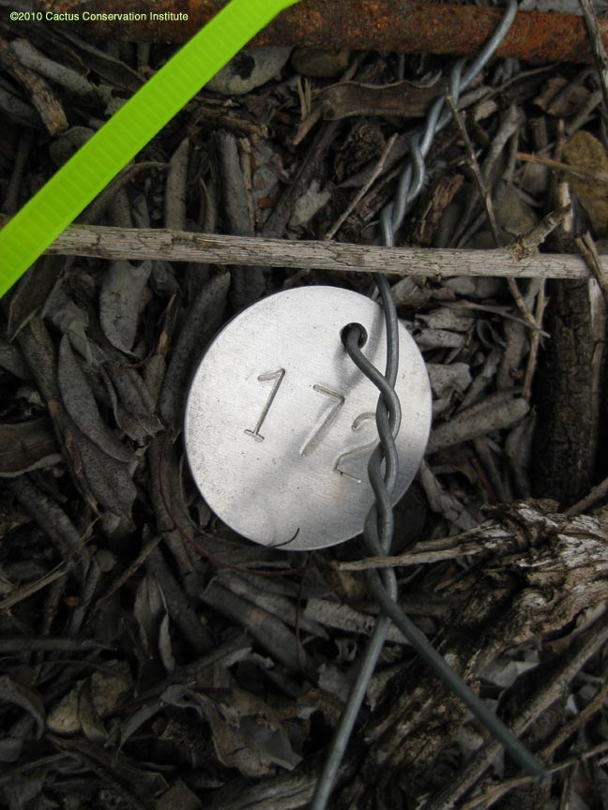
Control Site 172 - 2010
Wow, what’s this? Hmmm…fortunately we added rebar stakes double marking our Sites last year.

Slide 222
Control Site 172 - 2010

Slide 223
Control Site 173 - 2009

Slide 224
Control Site 173 - 2010

Slide 225
Control Site 173 - 2010

Slide 226
Control Site 174 - 2009

Slide 227
Control Site 174 - 2010

Slide 228
Control Site 175 - 2009

Slide 229
Control Site 175 - 2010

Slide 230
Control Site 175 - 2010

Slide 231
Control Site 176 - 2009

Slide 232
Control Site 176 - 2010

Slide 233
Control Site 176 - 2010

Slide 234
Control Site 177 - 2009

Slide 235
Control Site 177 - 2010

Slide 236
Control Site 177 - 2010

Slide 237
Control Site 178 - 2009

Slide 238
Control Site 178 - 2010

Slide 239
Control Site 178 - 2010

Slide 240
Control Site 178 - 2010

Slide 241
Control Site 179 - 2009

Slide 242
Control Site 179 - 2010

Slide 243
Control Site 179 - 2010

Slide 244
Control Site 180 - 2009

Slide 245
Control Site 180 - 2010

Slide 246
Control Site 180 - 2010

Slide 247
Control Site 180 - 2010

Slide 248
Control Site 181 - 2009

Slide 249
Control Site 181 - 2010

Slide 250
Control Site 182 - 2009

Slide 251
Control Site 182 - 2010

Slide 252
Control Site 182 - 2010

Slide 253
Control Site 183 - 2009

Slide 254
Control Site 183 - 2010

Slide 255
Control Site 184 - 2009

Slide 256
Control Site 184 - 2010

Slide 257
Control Site 185 - 2009

Slide 258
Control Site 185 - 2010

Slide 259
Control Site 186 - 2009

Slide 260
Control Site 186 - 2010

Slide 261
Control Site 186 - 2010

Slide 262
Control Site 186 - 2010

Slide 263
Control Site 186 - 2010

Slide 264
Control Site 187 - 2009

Slide 265
Control Site 187 - 2010

Slide 266
Control Site 187 - 2010

Slide 267
Control Site 187 - 2010

Slide 268
Control Site 188 - 2009

Slide 269
Control Site 188 - 2010

Slide 270
Control Site 188 - 2010

Slide 271
Control Site 189 - 2009

Slide 272
Control Site 189 - 2010

Slide 273
Control Site 189 - 2010

Slide 274
Control Site 190 - 2009

Slide 275
Control Site 190 - 2010

Slide 276
Control Site 190 - 2010

Slide 277
Control Site 190 - 2010

Slide 278
Control Site 190 - 2010

Slide 279
Control Site 190 - 2010

Slide 280
Control Site 190 - 2010

Slide 281
Control Site 190 - 2010

Slide 282
Control Site 190 - 2010

Slide 283
Control Site 191 - 2009

Slide 284
Control Site 191 - 2010

Slide 285
Control Site 191 - 2010

Slide 286
Control Site 192 - 2009

Slide 287
Control Site 192 - 2010

Slide 288
Control Site 193 - 2009

Slide 289
Control Site 193 - 2009

Slide 290
Control Site 193 - 2009

Slide 291
Control Site 193 - 2010

Slide 292
Control Site 193 - 2010

Slide 293
Control Site 193 - 2010

Slide 294
Control Site 193 - 2010

Slide 295
Control Site 194 - 2009

Slide 296
Control Site 194 - 2010

Slide 297
Control Site 194 - 2010

Slide 298
Control Site 194 - 2010

Slide 299
Control Site 194 - 2010

Slide 300
Control Site 194 - 2010

Slide 301
Control Site 195 - 2009

Slide 302
Control Site 195 - 2010

Slide 303
Control Site 196 - 2009

Slide 304
Control Site 196 - 2010

Slide 305
Control Site 197 - 2010

Slide 306
Control Site 197 - 2010

Slide 307
Control Site 198 - 2009

Slide 308
Control Site 198 - 2010

Slide 309
Control Site 199 - 2009

Slide 310
Control Site 199 - 2010

Slide 311
Control Site 199 - 2010

Slide 312
Control Site 200 - 2009

Slide 313
Control Site 200 - 2010

