Slide 1
Regrowth Assessment Protocol for a study of peyote harvesting
Cactus Conservation Institute’s signature study on the impact of peyote harvesting is the only longitudinal study ever conducted on this species.
This study is ongoing and new data will be reported as CCI has resources and as long as the plants themselves remain in the field to study.
These images were gathered during 2014.
Copyright Cactus Conservation Institute, 2009-2020. All rights reserved.

Slide 2
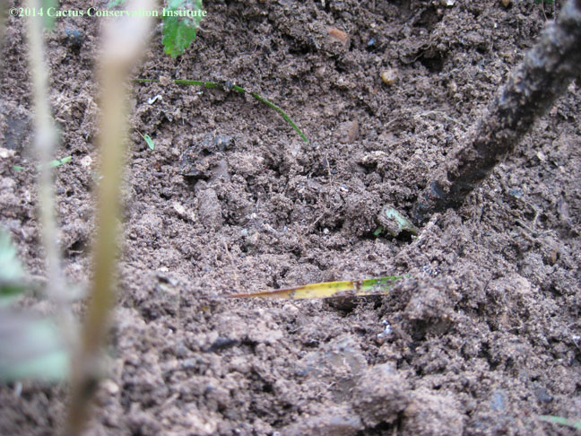
Site 101 - 2014
No regrowth on #101

Slide 3
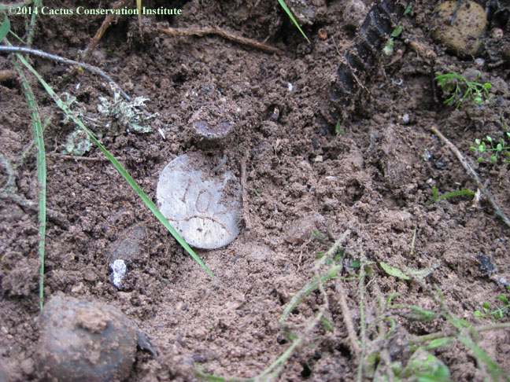
Site 102* - 2014
*Still no sign of 102 other than its tag

Slide 4
Site 103* - 2014
*Regrowth on 103

Slide 5
Site 103* - 2014
*Regrowth on 103

Slide 6
Site 103* - 2014
*Regrowth on 103

Slide 7
Site 103* - 2014
*Regrowth on 103

Slide 8
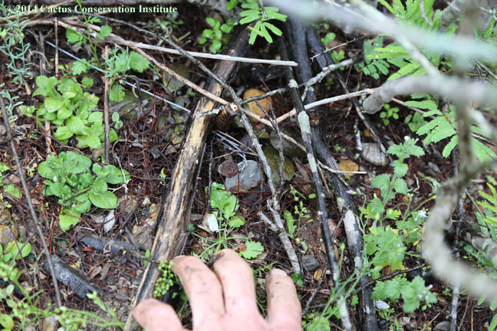
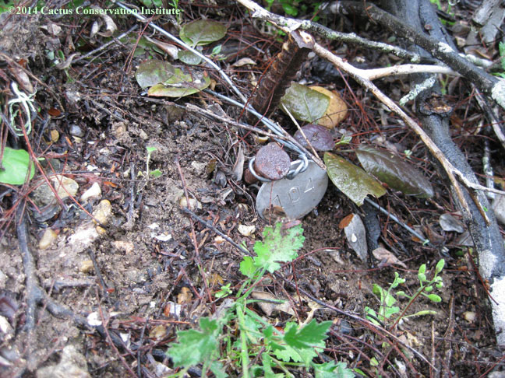
Site 104 - 2014
No apparent regrowth on #104.

Slide 9
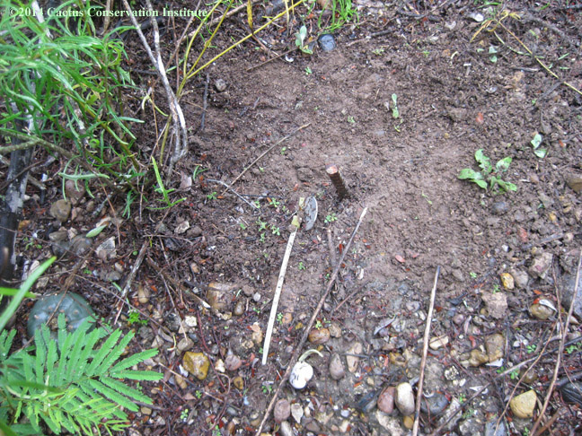
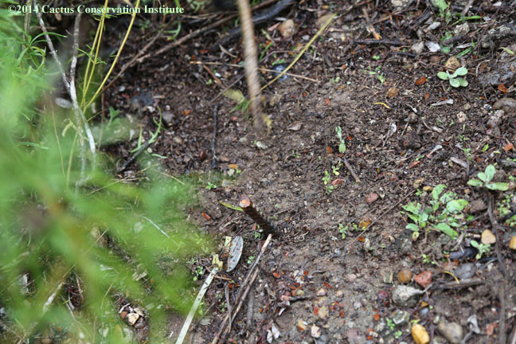
Site 105 - 2014
No regrowth from #105. Listed as “dead” since the first return visit.

Slide 10
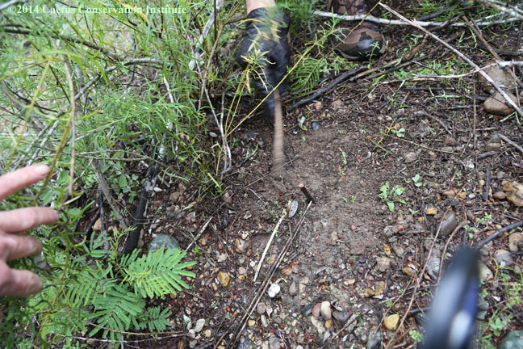
Site 105 - 2014
No regrowth from #105. Listed as “dead” since the first return visit.

Slide 11
Site 106 - 2014
Large heads are older growth. Regrowth is located at the base of the largest head. This was the source of some confusion in previous visits.

Slide 12
Site 106 - 2014
Large heads are older growth. Regrowth is located at the base of the largest head. This was the source of some confusion in previous visits.

Slide 13
Site 106 - 2014
Large heads are older growth. Regrowth is located at the base of the largest head. This was the source of some confusion in previous visits.

Slide 14
Site 106 - 2014
Large heads are older growth. Regrowth is located at the base of the largest head. This was the source of some confusion in previous visits.

Slide 15
Site 106 - 2014
Large heads are older growth. Regrowth is located at the base of the largest head. This was the source of some confusion in previous visits.

Slide 16
Site 106 - 2014
Large heads are older growth. Regrowth is located at the base of the largest head. This was the source of some confusion in previous visits.

Slide 17
Site 106 - 2014
Large heads are older growth. Regrowth is located at the base of the largest head. This was the source of some confusion in previous visits.

Slide 18
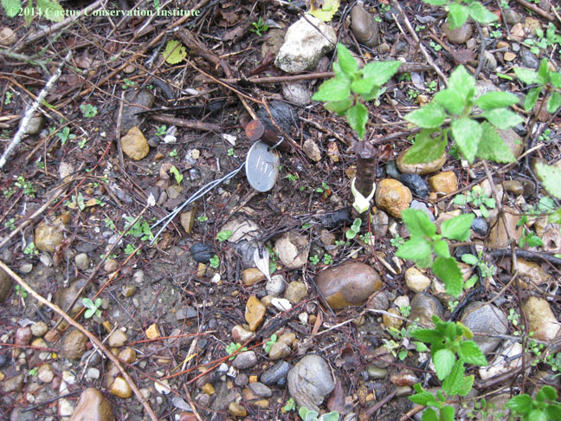
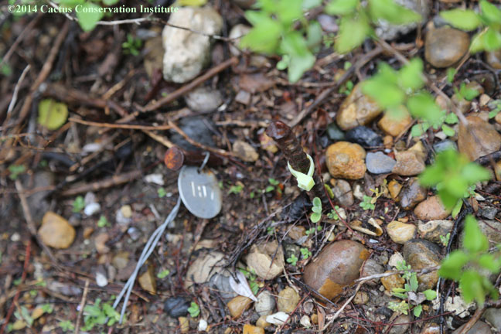
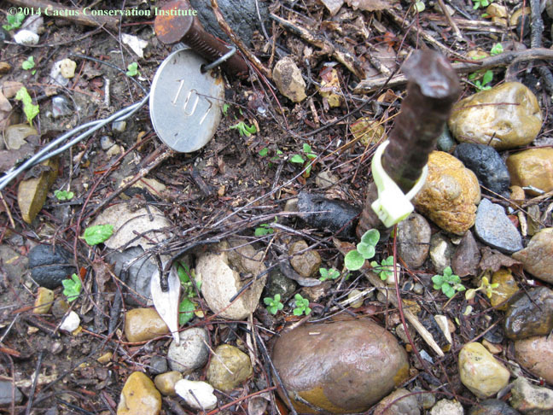
Site 107 - 2014
#107 is dead. Site remains were still apparent on 13 March 2012.

Slide 19
Site 108 - 2014
Regrowth on #108

Slide 20
Site 108 - 2014
Regrowth on #108

Slide 21
Site 108 - 2014
Regrowth on #108

Slide 22
Site 108 - 2014
Regrowth on #108

Slide 23
Site 108 - 2014
Regrowth on #108

Slide 24
Site 108 - 2014
Regrowth on #108

Slide 25
Site 108 - 2014
Regrowth on #108. Plant on upper right is a seedling.

Slide 26
Site 109 - 2014
Regrowth on #109

Slide 27
Site 109 - 2014
Regrowth on #109

Slide 28
Site 109 - 2014
Regrowth on #109

Slide 29
Site 109 - 2014
Regrowth on #109

Slide 30
Site 109 - 2014
Regrowth on #109

Slide 31
Site 109 - 2014
Regrowth on #109

Slide 32
Site 109 - 2014
Regrowth on #109

Slide 33
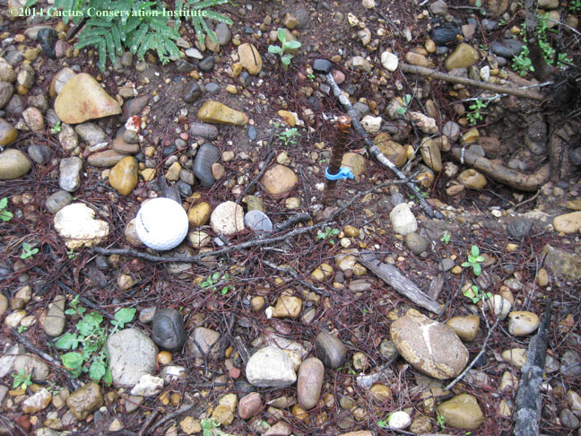
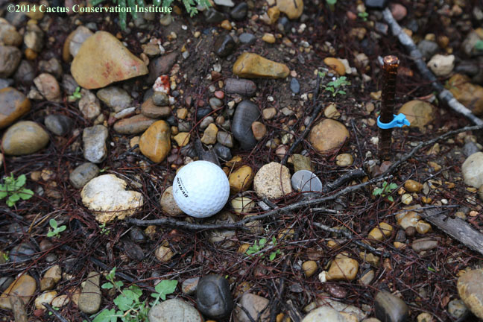
Site 110 - 2014
No apparent regrowth on #110.

Slide 34
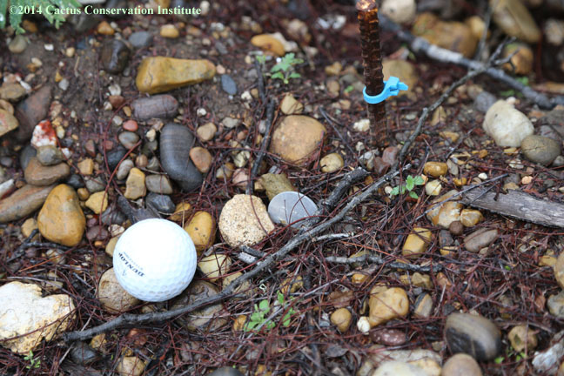
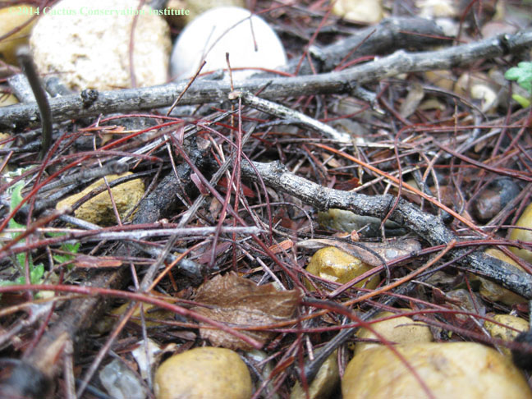
Site 110 - 2014
No apparent regrowth on #110.

Slide 35
Site 111 – 2014/2016
In 2014, we were unable to locate #111– or its tag or rebar.
In 2016, #111 was skipped due to time constraints and a history of absence.

Slide 36
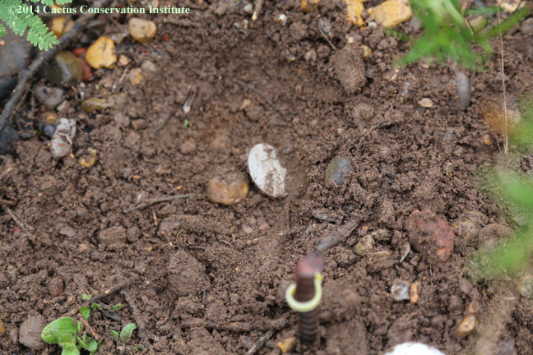
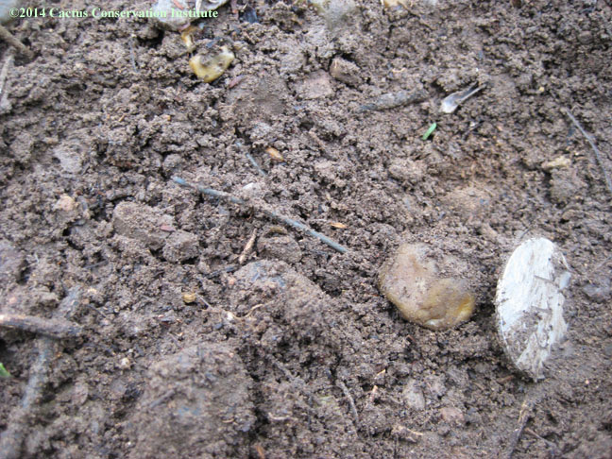
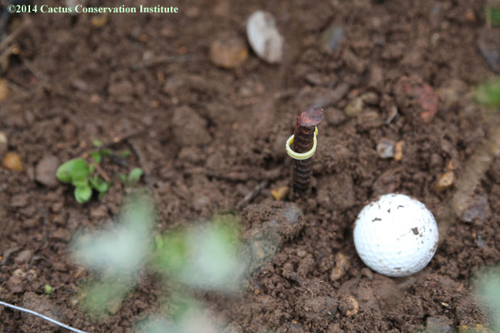
Site 112 - 2014
No regrowth on #112

Slide 37
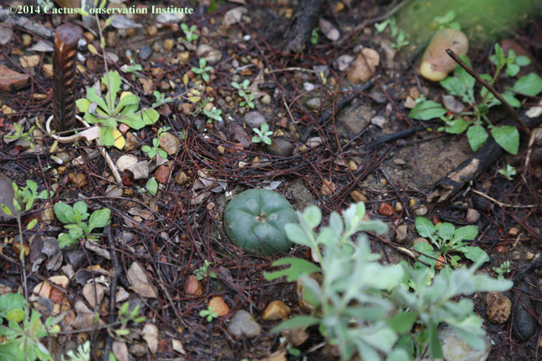
Site 113 - 2014
This is a new seedling and not #113.

Slide 38
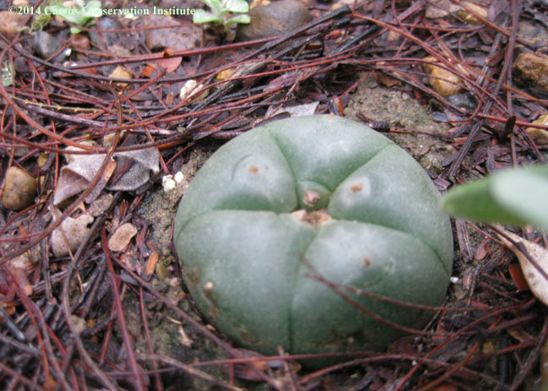
Site 113 - 2014
This is a new seedling and not #113.

Slide 39
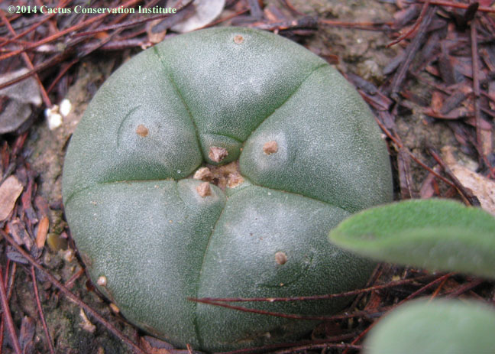
Site 113 - 2014
This is a new seedling and not #113.

Slide 40
Site 114 - 2014
Regrowth on #114.

Slide 41
Site 114 - 2014
Regrowth on #114.

Slide 42
Site 114 - 2014
Regrowth on #114.

Slide 43
Site 114 - 2014
Regrowth on #114.

Slide 44
Site 114 - 2014
Regrowth on #114.

Slide 45
Site 114 - 2014
Regrowth on #114.

Slide 46
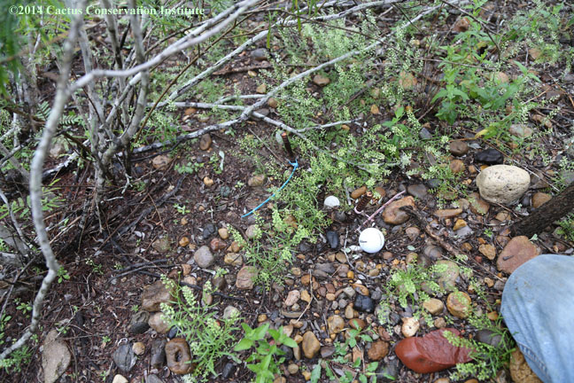
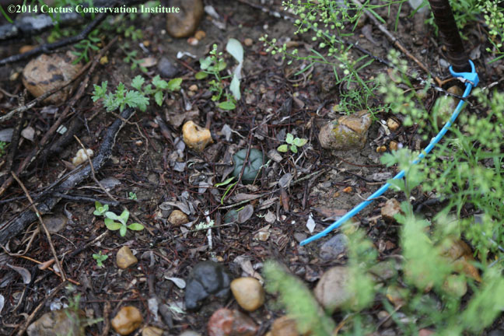
Site 115 - 2014
The tag for #115 is still there. This one has been presumed dead since our first return trip.

Slide 47
Site 115 - 2014
The tag for #115 is still there. This one has been presumed dead since our first return trip.

Slide 48
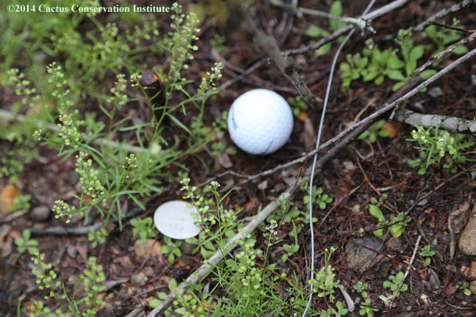
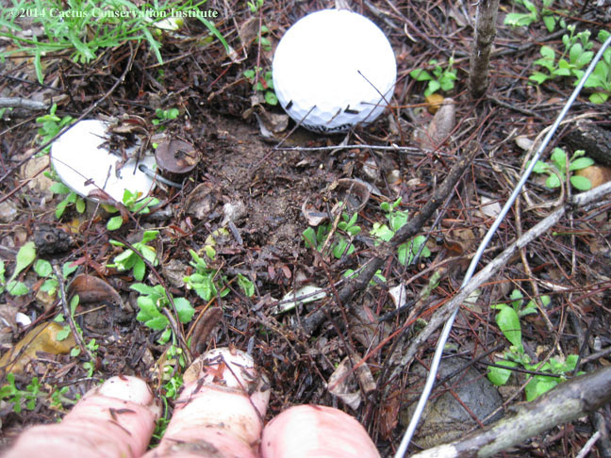
Site 116 – 2014
No apparent regrowth on #116

Slide 49
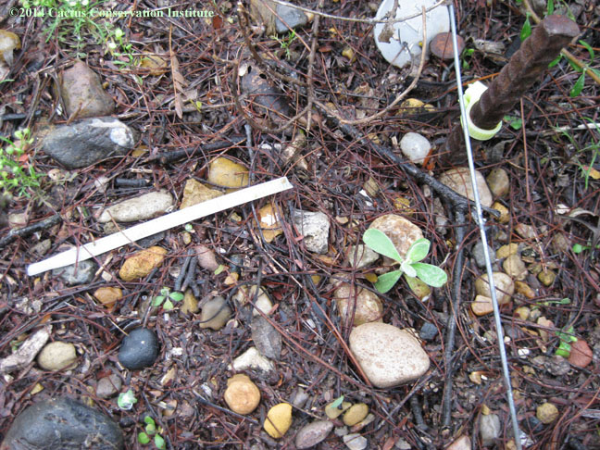
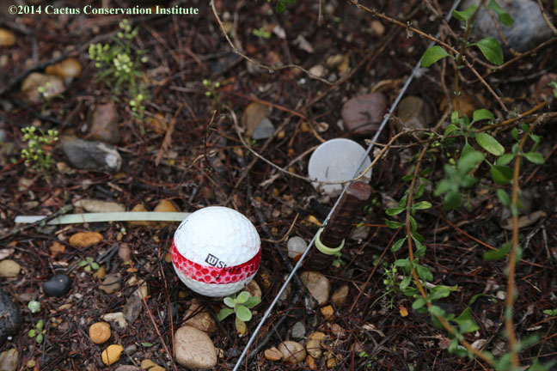
Site 117 - 2014
No apparent regrowth on #117

Slide 50
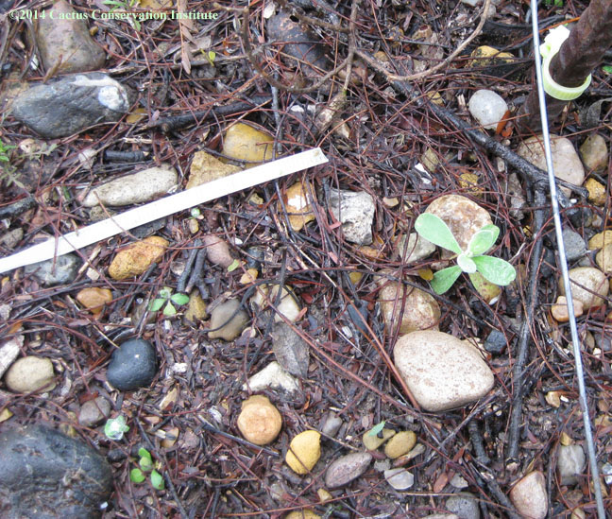
Site 117 - 2014
No apparent regrowth on #117

Slide 51
Site 118 - 2014
Regrowth on #118

Slide 52
Site 118 - 2014
Regrowth on #118

Slide 53
Site 118 - 2014
Regrowth on #118

Slide 54
Site 118 - 2014
Regrowth on #118

Slide 55
Site 118 - 2014
Regrowth on #118

Slide 56
Site 118 - 2014
Regrowth on #118

Slide 57
Site 119 - 2014
Regrowth on #119

Slide 58
Site 119 - 2014
Regrowth on #119

Slide 59
Site 119 - 2014
Regrowth on #119

Slide 60
Site 119 - 2014
Regrowth on #119

Slide 61
Site 119 - 2014
Regrowth on #119

Slide 62
Site 119 - 2014
Regrowth on #119

Slide 63
Site 119 - 2014
Regrowth on #119

Slide 64
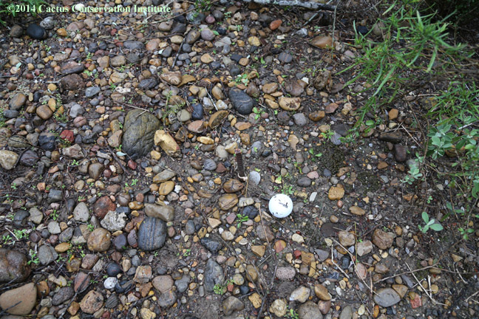
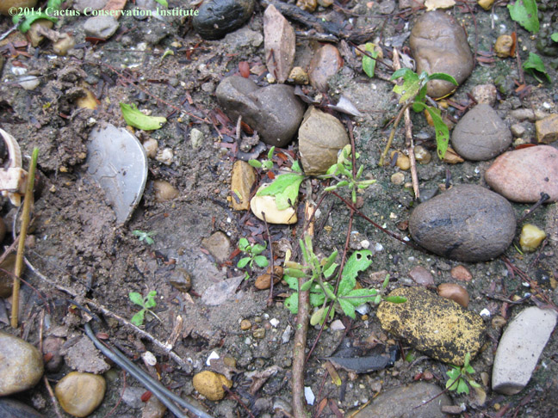
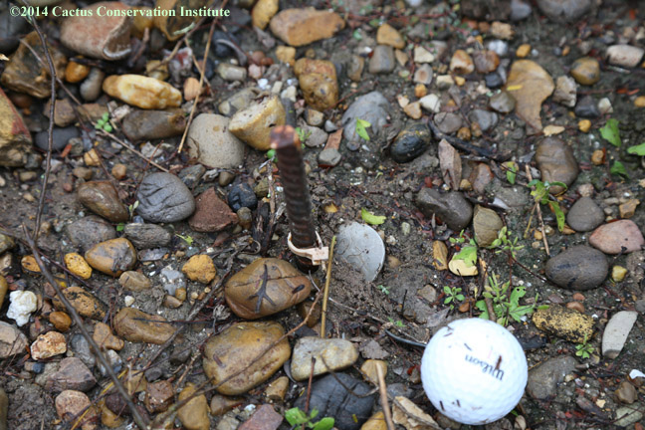
Site 120 - 2014
No regrowth on #120

Slide 65
Site 121 - 2014
Regrowth on #121

Slide 66
Site 121 - 2014
Regrowth on #121

Slide 67
Site 121 - 2014
Regrowth on #121

Slide 68
Site 121 - 2014
Regrowth on #121

Slide 69
Site 121 - 2014
Regrowth on #121

Slide 70
Site 121 - 2014
Regrowth on #121

Slide 71
Site 122 - 2014
Regrowth on #122

Slide 72
Site 122 - 2014
Regrowth on #122

Slide 73
Site 122 - 2014
Regrowth on #122

Slide 74
Site 122 - 2014
Regrowth on #122

Slide 75
Site 123 - 2014
Regrowth on #123

Slide 76
Site 123 - 2014
Regrowth on #123

Slide 77
Site 123 - 2014
Regrowth on #123

Slide 78
Site 123 - 2014
Regrowth on #123

Slide 79
Site 123 - 2014
Regrowth on #123

Slide 80
Site 124 - 2014
Regrowth on #124

Slide 81
Site 124 - 2014
Regrowth on #124

Slide 82
Site 124 - 2014
Regrowth on #124

Slide 83
Site 124 - 2014
Regrowth on #124

Slide 84
Site 124 - 2014
Regrowth on #124

Slide 85
Site 124 - 2014
Regrowth on #124

Slide 86
Site 125 - 2014
Regrowth on #125

Slide 87
Site 125 - 2014
Regrowth on #125

Slide 88
Site 125 - 2014
Regrowth on #125

Slide 89
Site 125 - 2014
Regrowth on #125

Slide 90
Site 125 - 2014
Regrowth on #125

Slide 91
Site 125 - 2014
Regrowth on #125

Slide 92
Site 126 - 2014
Regrowth on #126

Slide 93
Site 126 - 2014
Regrowth on #126

Slide 94
Site 126 - 2014
Regrowth on #126

Slide 95
Site 126 - 2014
Regrowth on #126

Slide 96
Site 126 - 2014
Regrowth on #126

Slide 97
Site 126 - 2014
Regrowth on #126

Slide 98
Site 126 - 2014
Regrowth on #126

Slide 99
Site 126 - 2014
Regrowth on #126

Slide 100
Site 126 - 2014
Regrowth on #126

Slide 101
Site 126 - 2014
Regrowth on #126

Slide 102
Site 127 - 2014
Regrowth on #127

Slide 103
Site 127 - 2014
Regrowth on #127

Slide 104
Site 127 - 2014
Regrowth on #127

Slide 105
Site 127 - 2014
Regrowth on #127

Slide 106
Site 127 - 2014
Regrowth on #127

Slide 107
Site 128 - 2014
Regrowth on #128

Slide 108
Site 128 - 2014
Regrowth on #128

Slide 109
Site 128 - 2014
Regrowth on #128

Slide 110
Site 128 - 2014
Regrowth on #128

Slide 111
Site 128 - 2014
Regrowth on #128

Slide 112
Site 128 - 2014
Regrowth on #128

Slide 113
Site 128 - 2014
Regrowth on #128

Slide 114
Site 129 - 2014
Regrowth on #129

Slide 115
Site 129 - 2014
Regrowth on #129

Slide 116
Site 129 - 2014
Regrowth on #129

Slide 117
Site 129 - 2014
Regrowth on #129

Slide 118
Site 129 - 2014
Regrowth on #129

Slide 119
Site 129 - 2014
Regrowth on #129

Slide 120
Site 129 - 2014
Regrowth on #129

Slide 121
Site 130 - 2014
Regrowth on #130
.

Slide 122
Site 130 - 2014
Regrowth on #130
.

Slide 123
Site 130 - 2014
Regrowth on #130
.

Slide 124
Site 130 - 2014
Regrowth on #130
.

Slide 125
Site 130 - 2014
Regrowth on #130
.

Slide 126
Site 130 - 2014
Regrowth on #130
.

Slide 127
Site 131 - 2014
Regrowth on #131

Slide 128
Site 131 - 2014
Regrowth on #131

Slide 129
Site 131 - 2014
Regrowth on #131

Slide 130
Site 131 - 2014
Regrowth on #131

Slide 131
Site 131 - 2014
Regrowth on #131

Slide 132
Site 131 - 2014
Regrowth on #131

Slide 133
Site 131 - 2014
Regrowth on #131

Slide 134
Site 132 - 2014
No sign of regrowth or #132

Slide 135
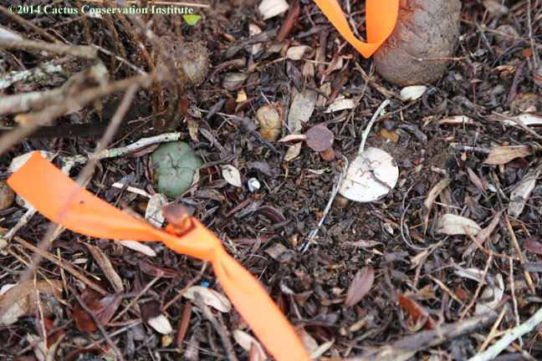
Site 133 - 2014
Regrowth on #133

Slide 136
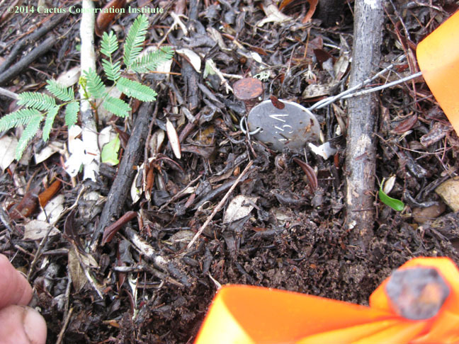
Site 134 - 2014
#134

Slide 137
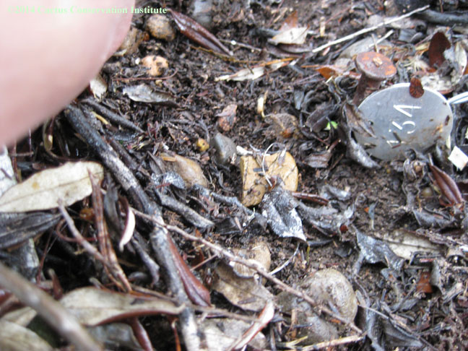
Site 134 - 2014
#134

Slide 138
Site 135 – 2014

Slide 139
Site 135 – 2014

Slide 140
Site 135 – 2014

Slide 141
Site 135 – 2014

Slide 142
Site 135 – 2014

Slide 143
Site 136 - 2014
Regrowth on #136

Slide 144
Site 137 - 2014
Regrowth on #137

Slide 145
Site 137 - 2014
Regrowth on #137

Slide 146
Site 137 - 2014
Regrowth on #137

Slide 147
Site 137 - 2014
Regrowth on #137

Slide 148
Site 137 - 2014
Regrowth on #137

Slide 149
Site 137 - 2014
Regrowth on #137

Slide 150
Site 137 - 2014
Regrowth on #137

Slide 151
Site 137 - 2014
Regrowth on #137

Slide 152
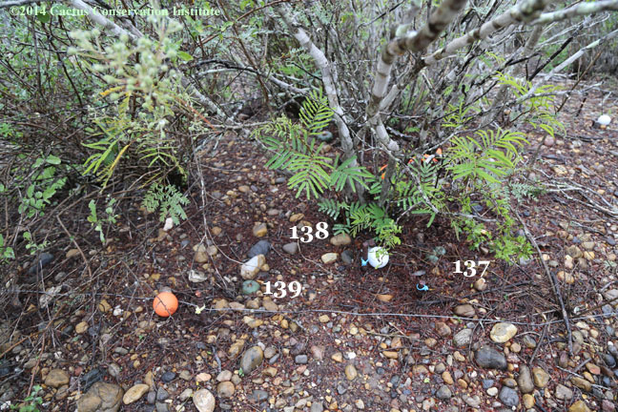
Site 138 - 2014
Somehow we missed a close-up on #138

Slide 153
Site 139 - 2014
Regrowth on #139

Slide 154
Site 139 - 2014
Regrowth on #139

Slide 155
Site 139 - 2014
Regrowth on #139

Slide 156
Site 139 - 2014
Regrowth on #139

Slide 157
Site 139 - 2014
Regrowth on #139

Slide 158
Site 139 - 2014
Regrowth on #139

Slide 159
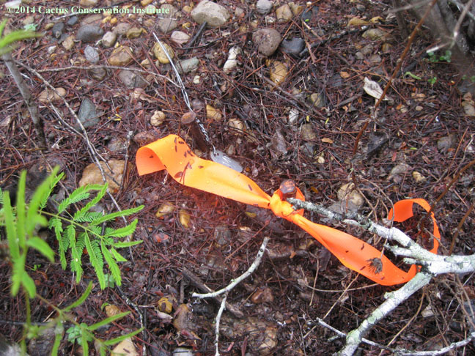
Site 140 - 2014
Plant remains (dead) were successfully located on 26-July-2010. Carcass was still locatable 13 March 2012 but not in March of 2014.

Slide 160
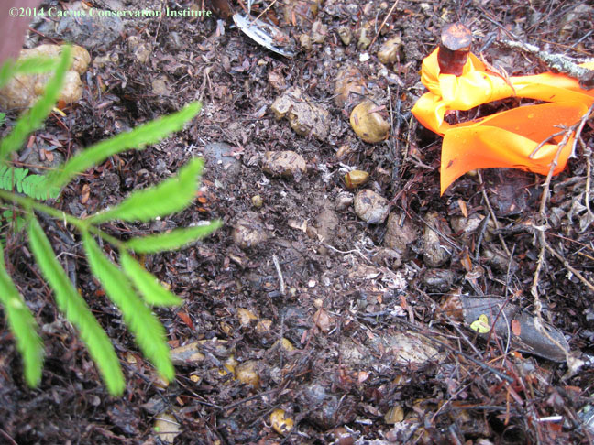
Site 140 - 2014
Plant remains (dead) were successfully located on 26-July-2010. Carcass was still locatable 13 March 2012 but not in March of 2014.

Slide 161
Site 141 - 2014
Regrowth on #141

Slide 162
Site 141 - 2014
Regrowth on #141

Slide 163
Site 141 - 2014
Regrowth on #141

Slide 164
Site 141 - 2014
Regrowth on #141

Slide 165
Site 141 - 2014
Regrowth on #141

Slide 166
Site 141 - 2014
Regrowth on #141

Slide 167
Site 141 - 2014
Regrowth on #141

Slide 168
Site 142 - 2014
Regrowth on #142

Slide 169
Site 142 - 2014
Regrowth on #142

Slide 170
Site 142 - 2014
Regrowth on #142

Slide 171
Site 142 - 2014
Regrowth on #142

Slide 172
Site 142 - 2014
Regrowth on #142

Slide 173
Site 142 - 2014
Regrowth on #142

Slide 174
Site 142 - 2014
Regrowth on #142

Slide 175
Site 142 - 2014
Regrowth on #142

Slide 176
Site 142 - 2014
Regrowth on #142

Slide 177
Site 142 - 2014
Regrowth on #142

Slide 178
Site 143 - 2014
Regrowth on #143

Slide 179
Site 143 - 2014
Regrowth on #143

Slide 180
Site 143 - 2014
Regrowth on #143

Slide 181
Site 143 - 2014
Regrowth on #143

Slide 182
Site 143 - 2014
Regrowth on #143

Slide 183
Site 143 - 2014
Regrowth on #143

Slide 184
Site 143 - 2014
Regrowth on #143

Slide 185
Site 144 -2014
Regrowth on #144

Slide 186
Site 144 -2014
Regrowth on #144

Slide 187
Site 144 -2014
Regrowth on #144

Slide 188
Site 144 -2014
Regrowth on #144

Slide 189
Site 144 -2014
Regrowth on #144

Slide 190
Site 144 -2014
Regrowth on #144

Slide 191
Site 145 - 2014
Regrowth on #145

Slide 192
Site 145 - 2014
Regrowth on #145

Slide 193
Site 145 - 2014
Regrowth on #145

Slide 194
Site 146 - 2014
Regrowth on #146

Slide 195
Site 146 - 2014
Regrowth on #146

Slide 196
Site 146 - 2014
Regrowth on #146

Slide 197
Site 146 - 2014
Regrowth on #146

Slide 198
Site 146 - 2014
Regrowth on #146

Slide 199
Site 146 - 2014
Regrowth on #146

Slide 200
Site 146 - 2014
Regrowth on #146

Slide 201
Site 147 - 2014
Regrowth on #147

Slide 202
Site 147 - 2014
Regrowth on #147

Slide 203
Site 147 - 2014
Regrowth on #147

Slide 204
Site 148 - 2014
Regrowth on #148

Slide 205
Site 148 - 2014
Regrowth on #148

Slide 206
Site 148 - 2014
Regrowth on #148

Slide 207
Site 148 - 2014
Regrowth on #148

Slide 208
Site 148 - 2014
Regrowth on #148

Slide 209
Site 148 - 2014
Regrowth on #148

Slide 210
Site 149 - 2014
Regrowth on #149

Slide 211
Site 149 - 2014
Regrowth on #149

Slide 212
Site 149 - 2014
Regrowth on #149

Slide 213
Site 149 - 2014
Regrowth on #149

Slide 214
Site 149 - 2014
Regrowth on #149

Slide 215
Site 149 - 2014
Regrowth on #149

Slide 216
Site 149 - 2014
Regrowth on #149

Slide 217
Site 149 - 2014
Regrowth on #149

Slide 218
Site 150 - 2014
Control #150

Slide 219
Site 150 - 2014
Control #150

Slide 220
Site 150 - 2014
Control #150

Slide 221
Site 150 - 2014
Control #150

Slide 222
Control Site 151 - 2014
This area apparently experiences a lot of hog traffic. Both broken crowns we replanted were nowhere to be seen. The original control plant is still putting on new growth.

Slide 223
Control Site 151 - 2014
This area apparently experiences a lot of hog traffic. Both broken crowns we replanted were nowhere to be seen. The original control plant is still putting on new growth.

Slide 224
Control Site 151 - 2014

Slide 225
Control Site 151 - 2014
This area apparently experiences a lot of hog traffic. Both broken crowns we replanted were nowhere to be seen. The original control plant is still putting on new growth.

Slide 226
Control Site 151 - 2014
This area apparently experiences a lot of hog traffic. Both broken crowns we replanted were nowhere to be seen. The original control plant is still putting on new growth.

Slide 227
Control Site 151 - 2014
This area apparently experiences a lot of hog traffic. Both broken crowns we replanted were nowhere to be seen. The original control plant is still putting on new growth.

Slide 228
Control Site 151 - 2014
This area apparently experiences a lot of hog traffic. Both broken crowns we replanted were nowhere to be seen. The original control plant is still putting on new growth.

Slide 229
Control Site 152 - 2014
.

Slide 230
Control Site 152 - 2014
.

Slide 231
Control Site 152 - 2014
.

Slide 232
Control Site 152 - 2014
.

Slide 233
Control Site 152 - 2014
.

Slide 234
Control Site 152 - 2014
.

Slide 235
Control Site 152 - 2014
.

Slide 236
Control Site 152 - 2014
.

Slide 237
Control Site 153 - 2014

Slide 238
Control Site 153 - 2014

Slide 239
Control Site 153 - 2014

Slide 240
Control Site 153 - 2014

Slide 241
Control Site 154 - 2014

Slide 242
Control Site 154 - 2014

Slide 243
Control Site 154 - 2014

Slide 244
Control Site 154 - 2014

Slide 245
Control Site 154 - 2014

Slide 246
Control Site 154 - 2014

Slide 247
Control Site 154 - 2014

Slide 248
Control Site 154 - 2014

Slide 249
Control Site 154 - 2014

Slide 250
Control Site 154 - 2014

Slide 251
Control Site 154 - 2014

Slide 252
Control Site 155 - 2014

Slide 253
Control Site 155 - 2014

Slide 254
Control Site 155 - 2014

Slide 255
Control Site 155 - 2014

Slide 256
Control Site 155 - 2014

Slide 257
Control Site 155 - 2014

Slide 258
Control Site 156 - 2014

Slide 259
Control Site 156 - 2014

Slide 260
Control Site 156 - 2014

Slide 261
Control Site 156 - 2014

Slide 262
Control Site 156 - 2014

Slide 263
Control Site 156 - 2014

Slide 264
Control Site 156 - 2014

Slide 265
Control Site 156 - 2014

Slide 266
Control Site 157 - 2014

Slide 267
Control Site 157 - 2014

Slide 268
Control Site 157 - 2014

Slide 269
Control Site 157 - 2014

Slide 270
Control Site 157 - 2014

Slide 271
Control Site 157 - 2014

Slide 272
Control Site 157 - 2014

Slide 273
Control Site 158 - 2014

Slide 274
Control Site 158 - 2014

Slide 275
Control Site 158 - 2014

Slide 276
Control Site 158 - 2014

Slide 277
Control Site 158 - 2014

Slide 278
Control Site 159 - 2014

Slide 279
Control Site 159 - 2014

Slide 280
Control Site 159 - 2014

Slide 281
Control Site 159 - 2014

Slide 282
Control Site 160 - 2014

Slide 283
Control Site 160 - 2014

Slide 284
Control Site 160 - 2014

Slide 285
Control Site 160 - 2014

Slide 286
Control Site 161 - 2014

Slide 287
Control Site 161 - 2014

Slide 288
Control Site 161 - 2014

Slide 289
Control Site 161 - 2014

Slide 290
Control Site 161 - 2014

Slide 291
Control Site 161 - 2014

Slide 292
Control Site 162 - 2014

Slide 293
Control Site 162 - 2014

Slide 294
Control Site 162 - 2014

Slide 295
Control Site 162 - 2014

Slide 296
Control Site 162 - 2014

Slide 297
Control Site 162 - 2014

Slide 298
Control Site 162 - 2014

Slide 299
Control Site 163 - 2014

Slide 300
Control Site 163 - 2014

Slide 301
Control Site 163 - 2014

Slide 302
Control Site 163 - 2014

Slide 303
Control Site 164 - 2014

Slide 304
Control Site 164 - 2014

Slide 305
Control Site 164 - 2014

Slide 306
Control Site 164 - 2014

Slide 307
Control Site 164 - 2014

Slide 308
Control Site 164 - 2014

Slide 309
Control Site 164 - 2014

Slide 310
Control Site 164 - 2014

Slide 311
Control Site 164 - 2014

Slide 312
Control Site 164 - 2014

Slide 313
Control Site 164 - 2014

Slide 314
Control Site 164 - 2014

Slide 315
Control Site 164 - 2014

Slide 316
Control Site 164 - 2014

Slide 317
Control Site 165 - 2014

Slide 318
Control Site 165 - 2014

Slide 319
Control Site 165 - 2014

Slide 320
Control Site 165 - 2014

Slide 321
Control Site 165 - 2014

Slide 322
Control Site 165 - 2014

Slide 323
Control Site 165 - 2014

Slide 324
Control Site 166 - 2014

Slide 325
Control Site 166 - 2014

Slide 326
Control Site 166 - 2014
The tag had been separated from its nail by a few feet!

Slide 327
Control Site 166 - 2014

Slide 328
Control Site 166 - 2014

Slide 329
Control Site 166 - 2014

Slide 330
Control Site 166 - 2014

Slide 331
Control Site 166 - 2014

Slide 332
Control Site 166 - 2014

Slide 333
Control Site 166 - 2014

Slide 334
Control Site 166 - 2014

Slide 335
Control Site 166 - 2014

Slide 336
Control Site 166 - 2014

Slide 337
Control Site 166 - 2014

Slide 338
Control Site 166 - 2014

Slide 339
Control Site 167 - 2014

Slide 340
Control Site 167 - 2014

Slide 341
Control Site 167 - 2014

Slide 342
Control Site 167 - 2014

Slide 343
Control Site 167 - 2014

Slide 344
Control Site 167 - 2014

Slide 345
Control Site 167 - 2014

Slide 346
Control Site 167 - 2014

Slide 347
Control Site 167 - 2014

Slide 348
Control Site 167 - 2014

Slide 349
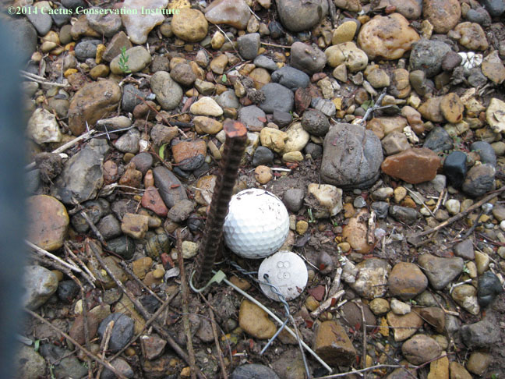
Control Site 168 - 2014
Control #168 was showing clear signs of disease in March 2010; we located its dead and dying corpse and decayed on 26 July 2010.

Slide 350
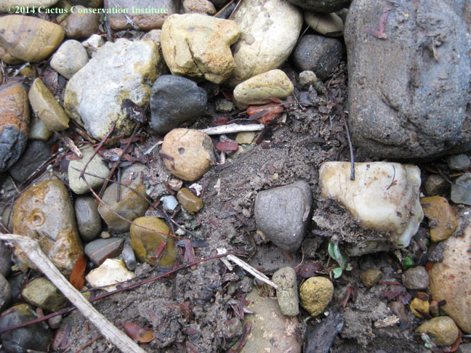
Control Site 168 - 2014
Control #168 was showing clear signs of disease in March 2010; we located its dead and dying corpse and decayed on 26 July 2010.

Slide 351
Control Site 169 - 2014

Slide 352
Control Site 169 - 2014

Slide 353
Control Site 169 - 2014

Slide 354
Control Site 169 - 2014

Slide 355
Control Site 170 - 2014

Slide 356
Control Site 170 - 2014

Slide 357
Control Site 170 - 2014

Slide 358
Control Site 170 - 2014

Slide 359
Control Site 170 - 2014

Slide 360
Control Site 171 - 2014

Slide 361
Control Site 171 - 2014

Slide 362
Control Site 171 - 2014

Slide 363
Control Site 171 - 2014

Slide 364
Control Site 171 - 2014

Slide 365
Control Site 171 - 2014

Slide 366
Control Site 172 - 2014

Slide 367
Control Site 172 - 2014

Slide 368
Control Site 172 - 2014

Slide 369
Control Site 172 - 2014

Slide 370
Control Site 172 - 2014

Slide 371
Control Site 173 - 2014

Slide 372
Control Site 173 - 2014

Slide 373
Control Site 173 - 2014

Slide 374
Control Site 174 - 2014

Slide 375
Control Site 174 - 2014

Slide 376
Control Site 174 - 2014

Slide 377
Control Site 175 - 2014

Slide 378
Control Site 175 - 2014

Slide 379
Control Site 176 - 2014

Slide 380
Control Site 176 - 2014

Slide 381
Control Site 176 - 2014

Slide 382
Control Site 177 - 2014

Slide 383
Control Site 177 - 2014

Slide 384
Control Site 177 - 2014

Slide 385
Control Site 177 - 2014

Slide 386
Control Site 178 - 2014

Slide 387
Control Site 178 - 2014

Slide 388
Control Site 178 - 2014

Slide 389
Control Site 178 - 2014

Slide 390
Control Site 179 - 2014

Slide 391
Control Site 179 - 2014

Slide 392
Control Site 179 - 2014

Slide 393
Control Site 179 - 2014

Slide 394
Control Site 179 - 2014

Slide 395
Control Site 179 - 2014

Slide 396
Control Site 180 - 2014

Slide 397
Control Site 180 - 2014

Slide 398
Control Site 180 - 2014

Slide 399
Control Site 180 - 2014

Slide 400
Control Site 180 - 2014

Slide 401
Control Site 180 - 2014

Slide 402
Control Site 181 - 2014

Slide 403
Control Site 181 - 2014

Slide 404
Control Site 181 - 2014

Slide 405
Control Site 181 - 2014

Slide 406
Control Site 181 - 2014

Slide 407
Control Site 182 - 2014
No sign of Control #182

Slide 408
Control Site 182 - 2014
No sign of Control #182

Slide 409
Control Site 182 - 2014
No sign of Control #182

Slide 410
Control Site 182 - 2014
No sign of Control #182

Slide 411
Control Site 183 - 2014
Site of Control #183

Slide 412
Control Site 183 - 2014
Site of Control #183

Slide 413
Control Site 183 - 2014
Site of Control #183

Slide 414
Control Site 183 - 2014
Site of Control #183

Slide 415
Control Site 184 - 2014

Slide 416
Control Site 184 - 2014

Slide 417
Control Site 184 - 2014

Slide 418
Control Site 185 - 2014

Slide 419
Control Site 185 - 2014

Slide 420
Control Site 185 - 2014

Slide 421
Control Site 185 - 2014

Slide 422
Control Site 186 - 2014

Slide 423
Control Site 186 - 2014

Slide 424
Control Site 186 - 2014

Slide 425
Control Site 186 - 2014

Slide 426
Control Site 186 - 2014

Slide 427
Control Site 186 - 2014

Slide 428
Control Site 186 - 2014

Slide 429
Control Site 186 - 2014

Slide 430
Control Site 186 - 2014

Slide 431
Control Site 186 - 2014

Slide 432
Control Site 186 - 2014

Slide 433
Control Site 186 - 2014

Slide 434
Control Site 187 - 2014

Slide 435
Control Site 187 - 2014

Slide 436
Control Site 187 - 2014

Slide 437
Control Site 187 - 2014

Slide 438
Control Site 187 - 2014

Slide 439
Control Site 188 - 2014

Slide 440
Control Site 189 - 2014

Slide 441
Control Site 189 - 2014

Slide 442
Control Site 189 - 2014

Slide 443
Control Site 189 - 2014

Slide 444
Control Site 190 - 2014

Slide 445
Control Site 190 - 2014

Slide 446
Control Site 190 - 2014

Slide 447
Control Site 191 - 2014

Slide 448
Control Site 191 - 2014

Slide 449
Control Site 191 - 2014

Slide 450
Control Site 192 - 2014

Slide 451
Control Site 192 - 2014

Slide 452
Control Site 192 - 2014

Slide 453
Control Site 192 - 2014

Slide 454
Control Site 193 - 2014

Slide 455
Control Site 193 - 2014

Slide 456
Control Site 193 - 2014

Slide 457
Control Site 193 - 2014

Slide 458
Control Site 193 - 2014

Slide 459
Control Site 193 - 2014

Slide 460
Control Site 194 - 2014

Slide 461
Control Site 195 - 2014

Slide 462
Control Site 195 - 2014

Slide 463
Control Site 195 - 2014

Slide 464
Control Site 195 - 2014

Slide 465
Control Site 195 - 2014

Slide 466
Control Site 196 - 2014

Slide 467
Control Site 196 - 2014

Slide 468
Control Site 197 - 2014

Slide 469
Control Site 197 - 2014

Slide 470
Control Site 197 - 2014

Slide 471
Control Site 197 - 2014

Slide 472
Control Site 198 - 2014
We declared #198 to be a dead plant last year. Its tag & nail had been found in the nearest Acacia berlandieri.

Slide 473
Control Site 198 - 2014
We declared #198 to be a dead plant last year. Its tag & nail had been found in the nearest Acacia berlandieri.

Slide 474
Control Site 199 - 2014

Slide 475
Control Site 199 - 2014

Slide 476
Control Site 199 - 2014

Slide 477
Control Site 200 - 2014

Slide 478
Control Site 200 - 2014

Slide 479
Control Site 200 - 2014

Slide 480
Control Site 200 - 2014

