Slide 1
Regrowth Assessment Protocol for a study of peyote harvesting
Cactus Conservation Institute’s signature study on the impact of peyote harvesting is the only longitudinal study ever conducted on this species.
This study is ongoing and new data will be reported as CCI has resources and as long as the plants themselves remain in the field to study.
These images were gathered in the 2016.
Copyright Cactus Conservation Institute, 2009-2020. All rights reserved.

Slide 2
Site 101 - 2016
#101 was skipped due to time constraints and a history of absence. No regrowth on #101.

Slide 3
Site 102 - 2016
#102 was skipped due to time constraints and a history of absence.

Slide 4
Site 103* - 2016
*The crown on the far right is a separate plant.

Slide 5
Site 103* - 2016
*Regrowth on #103.

Slide 6
Site 103* - 2016
*Regrowth on #103.

Slide 7
Site 103* - 2016
*This 3-crowned individual is growing next to #103 but is a separate plant.

Slide 8
Site 104 - 2016
#104 was skipped due to time constraints and a history of absence.

Slide 9
Site 105 - 2016
#105 was skipped due to time constraints and a history of absence.

Slide 10
Site 106 - 2009
Regrowth on #106

Slide 11
Site 106 - 2016
New regrowth crown is missing.
Large heads are older growth. Regrowth is located at the base of the largest head. This was the source of some confusion in previous visits.

Slide 12
Site 106 - 2016
New regrowth crown is missing.
Large heads are older growth. Regrowth is located at the base of the largest head. This was the source of some confusion in previous visits.

Slide 13
Site 106 - 2016
Large heads are older growth. Regrowth is located at the base of the largest head. This was the source of some confusion in previous visits.

Slide 14
Site 106 - 2016
Large heads are older growth. Regrowth is located at the base of the largest head. This was the source of some confusion in previous visits.

Slide 15
Site 106 - 2016
A bit of dried peyote stem ‘bark’
Large heads are older growth. Regrowth is located at the base of the largest head. This was the source of some confusion in previous visits.

Slide 16
Site 106 - 2016
Large heads are older growth. Regrowth is located at the base of the largest head. This was the source of some confusion in previous visits.

Slide 17
Site 106 - 2016
Large heads are older growth. Regrowth is located at the base of the largest head. This was the source of some confusion in previous visits.

Slide 18
Site 106 - 2016
Large heads are older growth. Regrowth is located at the base of the largest head. This was the source of some confusion in previous visits.

Slide 19
Site 107 - 2016
#107 was skipped due to time constraints and it is known to be dead.

Slide 20
Site 108 - 2016
No apparent regrowth on #108.

Slide 21
Site 109 - 2016
Regrowth on #109

Slide 22
Site 109 - 2016
Regrowth on #109

Slide 23
Site 111 – 2014/2016
In 2014, we were unable to locate #111– or its tag or rebar.
In 2016, #111 was skipped due to time constraints and a history of absence.

Slide 24
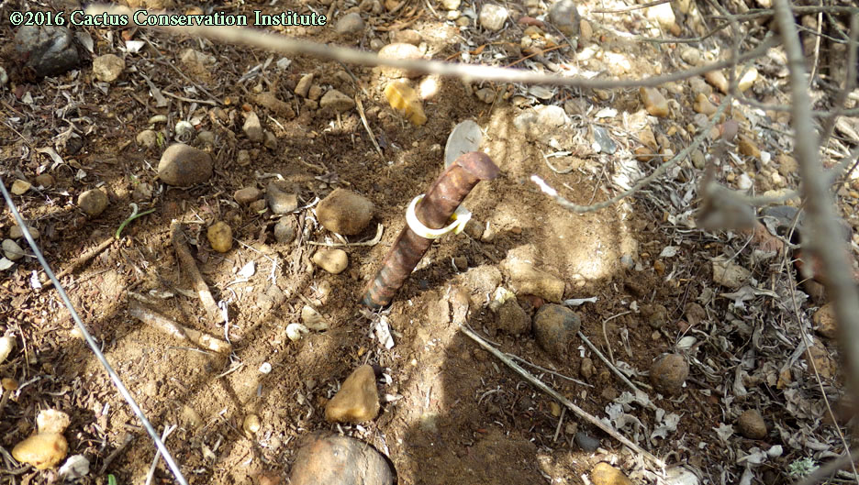
Site 112 - 2016
No regrowth on #112

Slide 25
Site 113 - 2016
#113 was nowhere to be seen

Slide 26
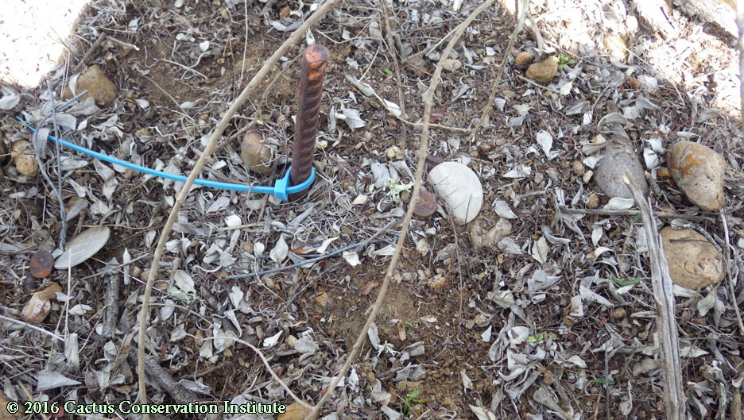
Site 114 - 2016
No regrowth visible on #114.

Slide 27
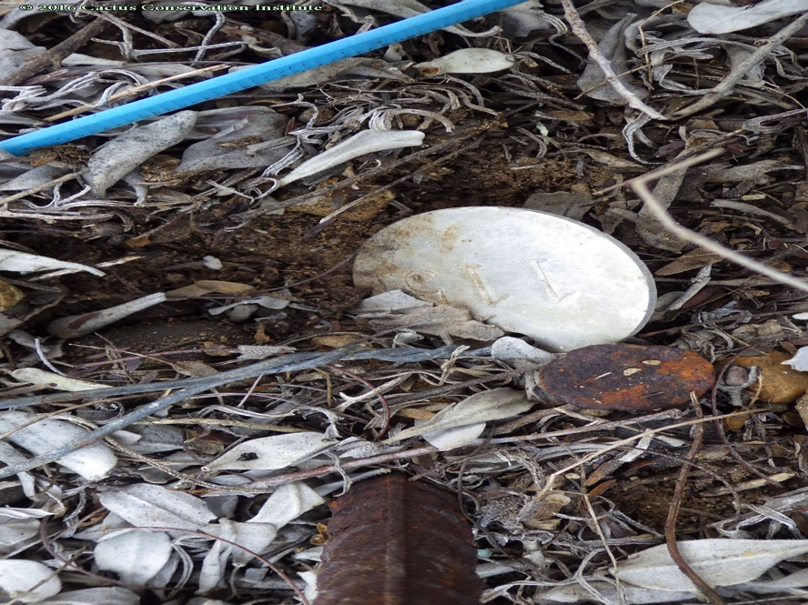
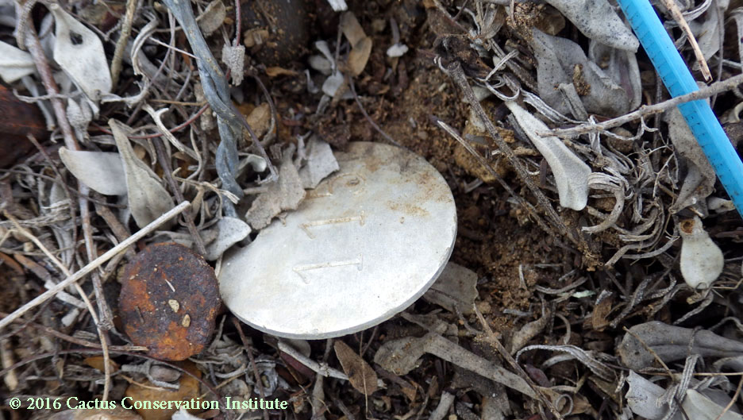
Site 115 - 2016
The tag for #115 is still there. This one has been presumed dead since our first return trip.

Slide 28
Site 116 – 2016
#116 was skipped due to time constraints and a history of absence.

Slide 29
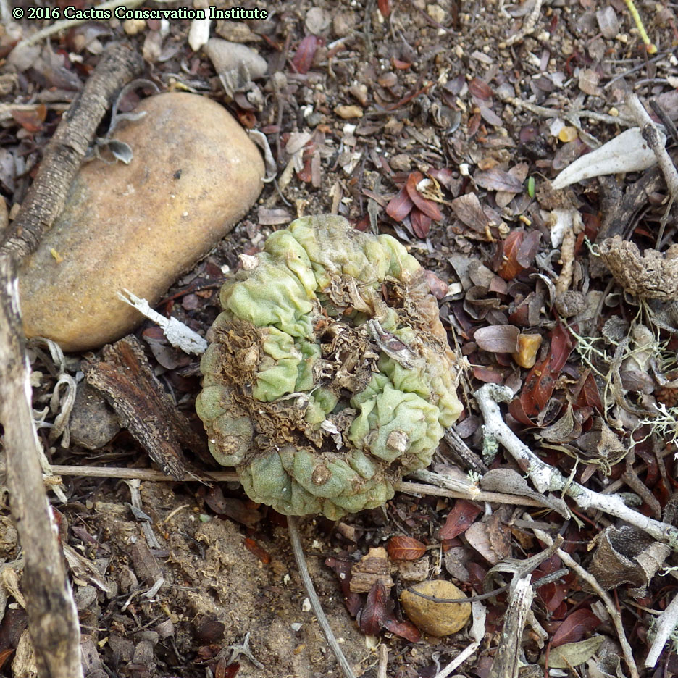
Site 117 - 2016
There was no apparent regrowth on #117. However, this loose crown was noticed a short distance from it.

Slide 30
Site 117 - 2016
There was no apparent regrowth on #117. However, this loose crown was noticed a short distance from it.

Slide 31
Site 118 - 2016
#118 was missed.

Slide 32
Site 119 - 2016
Regrowth on #119

Slide 33
Site 119 - 2016
Regrowth on #119

Slide 34
Site 119 - 2016
Regrowth on #119

Slide 35
Site 119 - 2016
Regrowth on #119

Slide 36
Site 119 - 2016
Regrowth on #119

Slide 37
Site 119 - 2016
Regrowth on #119

Slide 38
Site 119 - 2016
Regrowth on #119

Slide 39
Site 120 - 2016
#116 was skipped due to time constraints and a history of absence.

Slide 40
Site 121 - 2016
Regrowth on #121

Slide 41
Site 121 - 2016
Regrowth on #121

Slide 42
Site 121 - 2016
Regrowth on #121

Slide 43
Site 123 - 2016
Regrowth on #123 was partially eaten

Slide 44
Site 123 - 2016
Regrowth on #123 was partially eaten

Slide 45
Site 123 - 2016
Regrowth on #123 was partially eaten

Slide 46
Site 124 - 2016
Regrowth on #124

Slide 47
Site 124 - 2016
Regrowth on #124

Slide 48
Site 124 - 2016
Regrowth on #124

Slide 49
Site 124 - 2016
Regrowth on #124

Slide 50
Site 125 - 2016
Regrowth on #125

Slide 51
Site 125 - 2016
Regrowth on #125

Slide 52
Site 125 - 2016
Regrowth on #125

Slide 53
Site 125 - 2016
Regrowth on #125

Slide 54
Site 126 - 2016
Regrowth on #126

Slide 55
Site 126 - 2016
Regrowth on #126

Slide 56
Site 127 - 2016
Regrowth on #127

Slide 57
Site 127 - 2016
Regrowth on #127

Slide 58
Site 127 - 2016
Regrowth on #127

Slide 59
Site 127 - 2016
Regrowth on #127

Slide 60
Site 128 - 2016
Regrowth on #128

Slide 61
Site 128 - 2016
Regrowth on #128

Slide 62
Site 128 - 2016
Regrowth on #128

Slide 63
Site 128 - 2016
Regrowth on #128

Slide 64
Site 128 - 2016
Regrowth on #128

Slide 65
Site 129 - 2016
Regrowth on #129

Slide 66
Site 129 - 2016
Regrowth on #129

Slide 67
Site 129 - 2016
Regrowth on #129

Slide 68
Site 129 - 2016
Regrowth on #129

Slide 69
Site 130 - 2016
Regrowth on #130
.

Slide 70
Site 130 - 2016
Regrowth on #130
.

Slide 71
Site 130 - 2016
Regrowth on #130
.

Slide 72
Site 131 - 2016
Regrowth or #131

Slide 73
Site 131 - 2016
Regrowth or #131

Slide 74
Site 131 - 2016
Regrowth or #131

Slide 75
Site 132 - 2016
No sign of regrowth or #132

Slide 76
Site 133 - 2016
Regrowth on #133

Slide 77
Site 133 - 2016
Regrowth on #133

Slide 78
Site 133 - 2016
Regrowth on #133

Slide 79
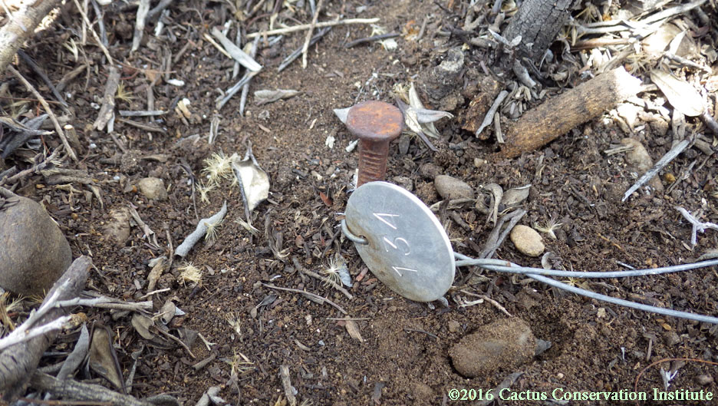
Site 134 - 2016
#134

Slide 80
Site 134 - 2016
#134

Slide 81
Site 134 - 2016
#134

Slide 82
Site 135 – 2016

Slide 83
Site 135 – 2016

Slide 84
Site 135 – 2016

Slide 85
Site 135 – 2016

Slide 86
Site 135 – 2016

Slide 87
Site 136 - 2016
Regrowth on #136

Slide 88
Site 136 - 2016
Regrowth on #136

Slide 89
Site 137 - 2016
Regrowth on #137

Slide 90
Site 137 - 2016
Regrowth on #137

Slide 91
Site 137 - 2016
Regrowth on #137

Slide 92
Site 138 - 2016
Somehow we missed a closer shot of the site of #138

Slide 93
Site 138 - 2016
Somehow we missed a closer shot of the site of #138

Slide 94
Site 138 - 2016
Somehow we missed a closer shot of the site of #138

Slide 95
Site 139 - 2016
Regrowth on #139

Slide 96
Site 139 - 2016
Regrowth on #139

Slide 97
Site 139 - 2016
Regrowth on #139

Slide 98
Site 139 - 2016
Regrowth on #139

Slide 99
Site 139 - 2016
Regrowth on #139

Slide 100
Site 140 - 2016
This plant is dead.

Slide 101
Site 141 - 2016
Regrowth on #141

Slide 102
Site 141 - 2016
Regrowth on #141

Slide 103
Site 142 - 2016
Regrowth on #142

Slide 104
Site 142 - 2016
Regrowth on #142

Slide 105
Site 142 - 2016
Regrowth on #142

Slide 106
Site 142 - 2016
Regrowth on #142

Slide 107
Site 142 - 2016
Regrowth on #142

Slide 108
Site 142 - 2016
Regrowth on #142

Slide 109
Site 142 - 2016
Regrowth on #142

Slide 110
Site 143 - 2016
Regrowth on #143

Slide 111
Site 143 - 2016
Regrowth on #143

Slide 112
Site 143 - 2016
Regrowth on #143

Slide 113
Site 144 -2016
Regrowth on #144

Slide 114
Site 144 -2016
Regrowth on #144

Slide 115
Site 144 -2016
Regrowth on #144

Slide 116
Site 144 -2016
Regrowth on #144

Slide 117
Site 145 - 2016
Regrowth on #145

Slide 118
Site 145 - 2016
Regrowth on #145

Slide 119
Site 145 - 2016
Regrowth on #145

Slide 120
Site 146 - 2016
Regrowth on #146

Slide 121
Site 146 - 2016
Regrowth on #146

Slide 122
Site 146 - 2016
Regrowth on #146

Slide 123
Site 147 - 2016
Regrowth on #147

Slide 124
Site 147 - 2016
Regrowth on #147

Slide 125
Site 147 - 2016
Regrowth on #147

Slide 126
Site 147 - 2016
Regrowth on #147

Slide 127
Site 148 - 2016
Regrowth on #148

Slide 128
Site 148 - 2016
Regrowth on #148

Slide 129
Site 148 - 2016
Regrowth on #148

Slide 130
Site 148 - 2016
Regrowth on #148

Slide 131
Site 149 - 2016
Regrowth on #149

Slide 132
Site 149 - 2016
Regrowth on #149

Slide 133
Site 149 - 2016
Regrowth on #149

Slide 134
Site 149 - 2016
Regrowth on #149

Slide 135
Site 150 - 2016
Control #150

Slide 136
Site 150 - 2016
Control #150

Slide 137
Site 150 - 2016
Control #150

Slide 138
Site 150 - 2016
Control #150

Slide 139
Site 150 - 2016
Control #150

Slide 140
Control Site 151 - 2016
This area apparently experiences a lot of hog traffic. Both broken crowns we replanted were nowhere to be seen. The original control plant is still putting on new growth.

Slide 141
Control Site 151 - 2016
This area apparently experiences a lot of hog traffic. Both broken crowns we replanted were nowhere to be seen. The original control plant is still putting on new growth.

Slide 142
Control Site 151 - 2016
This area apparently experiences a lot of hog traffic. Both broken crowns we replanted were nowhere to be seen. The original control plant is still putting on new growth.

Slide 143
Control Site 151 - 2016
This area apparently experiences a lot of hog traffic. Both broken crowns we replanted were nowhere to be seen. The original control plant is still putting on new growth.

Slide 144
Control Site 151 - 2016
This area apparently experiences a lot of hog traffic. Both broken crowns we replanted were nowhere to be seen. The original control plant is still putting on new growth.

Slide 145
Control Site 151 - 2016
This area apparently experiences a lot of hog traffic. Both broken crowns we replanted were nowhere to be seen. The original control plant is still putting on new growth.

Slide 146
Control Site 152 - 2016
.

Slide 147
Control Site 152 - 2016
.

Slide 148
Control Site 152 - 2016
.

Slide 149
Control Site 152 - 2016
.

Slide 150
Control Site 152 - 2016
.

Slide 151
Control Site 153 - 2016

Slide 152
Control Site 153 - 2016

Slide 153
Control Site 153 - 2016

Slide 154
Control Site 153 - 2016

Slide 155
Control Site 153 - 2016

Slide 156
Control Site 154 - 2016

Slide 157
Control Site 154 - 2016

Slide 158
Control Site 154 - 2016

Slide 159
Control Site 154 - 2016

Slide 160
Control Site 154 - 2016

Slide 161
Control Site 154 - 2016

Slide 162
Control Site 155 - 2016

Slide 163
Control Site 155 - 2016

Slide 164
Control Site 155 - 2016

Slide 165
Control Site 156 - 2016

Slide 166
Control Site 156 - 2016

Slide 167
Control Site 156 - 2016

Slide 168
Control Site 156 - 2016

Slide 169
Control Site 156 - 2016

Slide 170
Control Site 157 - 2016

Slide 171
Control Site 157 - 2016

Slide 172
Control Site 157 - 2016

Slide 173
Control Site 158 - 2016

Slide 174
Control Site 158 - 2016

Slide 175
Control Site 158 - 2016

Slide 176
Control Site 158 - 2016

Slide 177
Control Site 159 - 2016

Slide 178
Control Site 159 - 2016

Slide 179
Control Site 159 - 2016

Slide 180
Control Site 160 - 2016

Slide 181
Control Site 160 - 2016

Slide 182
Control Site 160 - 2016

Slide 183
Control Site 160 - 2016

Slide 184
Control Site 161 - 2016

Slide 185
Control Site 161 - 2016

Slide 186
Control Site 161 - 2016

Slide 187
Control Site 161 - 2016

Slide 188
Control Site 162 - 2016

Slide 189
Control Site 162 - 2016

Slide 190
Control Site 162 - 2016

Slide 191
Control Site 163 - 2016

Slide 192
Control Site 163 - 2016

Slide 193
Control Site 163 - 2016

Slide 194
Control Site 163 - 2016

Slide 195
Control Site 164 - 2016

Slide 196
Control Site 164 - 2016

Slide 197
Control Site 164 - 2016

Slide 198
Control Site 164 - 2016

Slide 199
Control Site 164 - 2016

Slide 200
Control Site 164 - 2016

Slide 201
Control Site 164 - 2016

Slide 202
Control Site 164 - 2016

Slide 203
Control Site 164 - 2016

Slide 204
Control Site 164 - 2016

Slide 205
Control Site 164 - 2016

Slide 206
Control Site 165 - 2016
Control #165 died of disease. It and its tag had been dug up. The hollowed-out center suggests that a cactus borer might have been involved but we have not yet determined the organism that was responsible.

Slide 207
Control Site 165 - 2016
Control #165 died of disease. It and its tag had been dug up. The hollowed-out center suggests that a cactus borer might have been involved but we have not yet determined the organism that was responsible.

Slide 208
Control Site 165 - 2016
Control #165 died of disease. It and its tag had been dug up. The hollowed-out center suggests that a cactus borer might have been involved but we have not yet determined the organism that was responsible.

Slide 209
Control Site 165 - 2016
Control #165 died of disease. It and its tag had been dug up. The hollowed-out center suggests that a cactus borer might have been involved but we have not yet determined the organism that was responsible.

Slide 210
Control Site 165 - 2016
Control #165 died of disease. It and its tag had been dug up. The hollowed-out center suggests that a cactus borer might have been involved but we have not yet determined the organism that was responsible.

Slide 211
Control Site 165 - 2016
Control #165 died of disease. It and its tag had been dug up. The hollowed-out center suggests that a cactus borer might have been involved but we have not yet determined the organism that was responsible.

Slide 212
Control Site 165 - 2016
Control #165 died of disease. It and its tag had been dug up. The hollowed-out center suggests that a cactus borer might have been involved but we have not yet determined the organism that was responsible.

Slide 213
Control Site 166 - 2016
There was no sign of Control #166. Its tag was noticed to be loose and on the ground.

Slide 214
Control Site 166 - 2016
There was no sign of Control #166. Its tag was noticed to be loose and on the ground.

Slide 215
Control Site 167 - 2016

Slide 216
Control Site 167 - 2016

Slide 217
Control Site 167 - 2016

Slide 218
Control Site 167 - 2016

Slide 219
Control Site 168 - 2016
Control #168 was skipped due to being known to be dead and decayed.
Control #168 was showing clear signs of disease in March 2010; we had last located its dead and dying corpse and decayed on 26 July 2010.

Slide 220
Control Site 169 - 2016

Slide 221
Control Site 169 - 2016

Slide 222
Control Site 169 - 2016

Slide 223
Control Site 170 - 2016

Slide 224
Control Site 170 - 2016

Slide 225
Control Site 171 - 2016

Slide 226
Control Site 171 - 2016

Slide 227
Control Site 171 - 2016

Slide 228
Control Site 171 - 2016

Slide 229
Control Site 172 - 2016

Slide 230
Control Site 172 - 2016

Slide 231
Control Site 172 - 2016

Slide 232
Control Site 173 - 2016

Slide 233
Control Site 173 - 2016

Slide 234
Control Site 174 - 2016

Slide 235
Control Site 174 - 2016

Slide 236
Control Site 174 - 2016

Slide 237
Control Site 175 - 2016

Slide 238
Control Site 175 - 2016

Slide 239
Control Site 176 - 2016

Slide 240
Control Site 176 - 2016

Slide 241
Control Site 176 - 2016

Slide 242
Control Site 176 - 2016

Slide 243
Control Site 176 - 2016

Slide 244
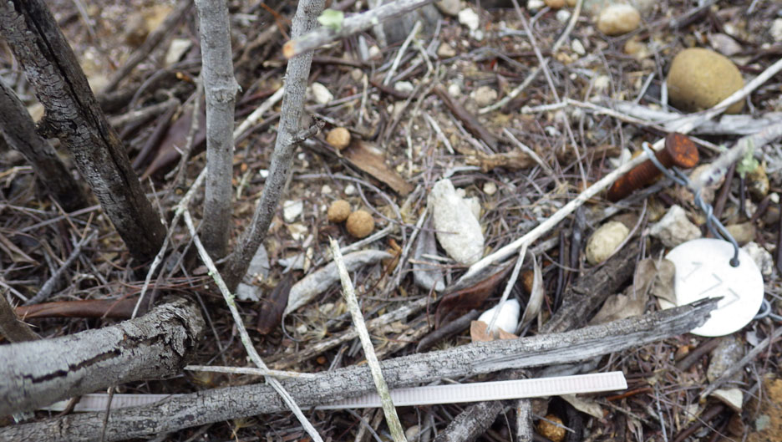
Control Site 177 - 2016
The site of Control #177 but there was no sign of the plant.

Slide 245
Control Site 177 - 2016
The site of Control #177 but there was no sign of the plant.

Slide 246
Control Site 178 - 2016

Slide 247
Control Site 178 - 2016

Slide 248
Control Site 178 - 2016

Slide 249
Control Site 178 - 2016

Slide 250
Control Site 179 - 2016

Slide 251
Control Site 179 - 2016

Slide 252
Control Site 179 - 2016

Slide 253
Control Site 179 - 2016

Slide 254
Control Site 180 - 2016

Slide 255
Control Site 180 - 2016

Slide 256
Control Site 180 - 2016

Slide 257
Control Site 180 - 2016

Slide 258
Control Site 180 - 2016

Slide 259
Control Site 180 - 2016

Slide 260
Control Site 181 - 2016

Slide 261
Control Site 181 - 2016

Slide 262
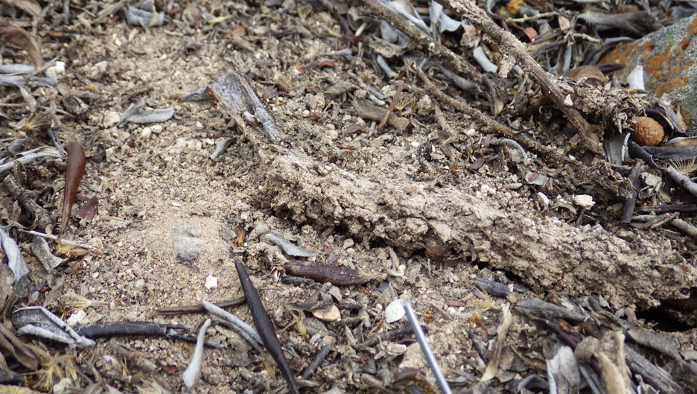
Control Site 182 - 2016
No sign of Control #182

Slide 263
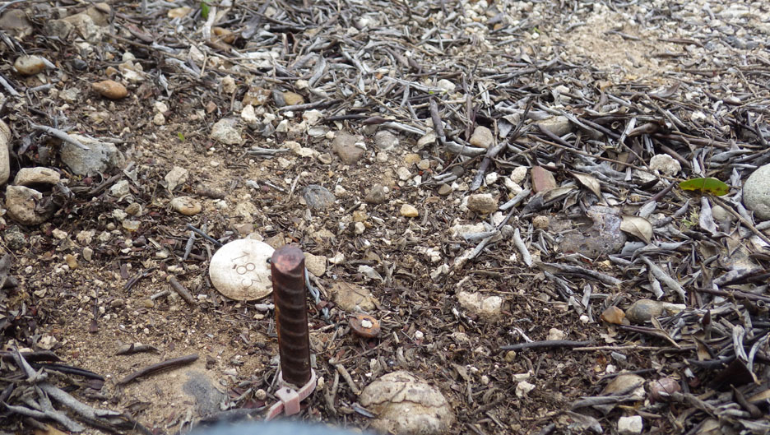
Control Site 183 - 2016
Site of Control #183

Slide 264
Control Site 183 - 2016
Site of Control #183

Slide 265
Control Site 184 - 2016
We missed photographing Control #184

Slide 266
Control Site 185 - 2016

Slide 267
Control Site 185 - 2016

Slide 268
Control Site 185 - 2016

Slide 269
Control Site 185 - 2016

Slide 270
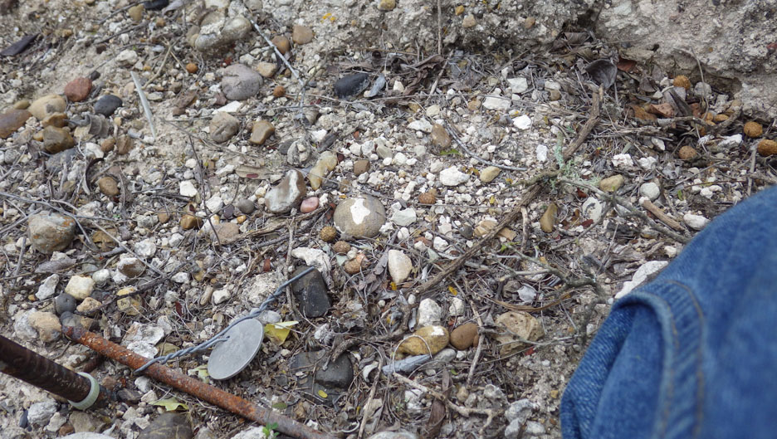
Control Site 186 - 2016
Control #186 was not locateable. Its tag had been unearthed and was loose on the ground.

Slide 271
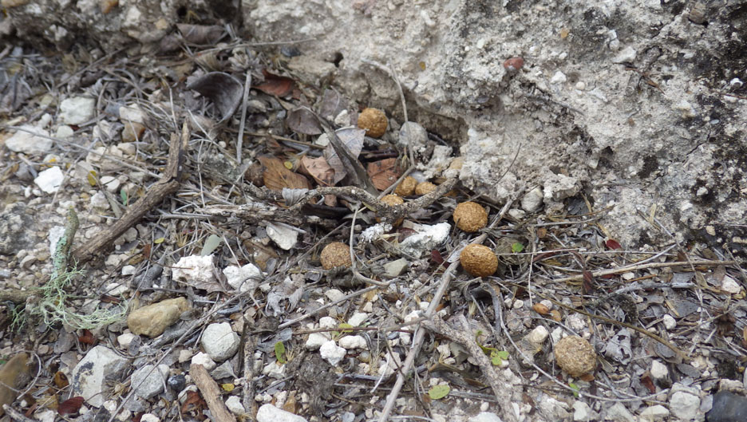
Control Site 186 - 2016
Control #186 was not locateable. Its tag had been unearthed and was loose on the ground.

Slide 272
Control Site 186 - 2016
Control #186 was not locateable. Its tag had been unearthed and was loose on the ground.

Slide 273
Control Site 187 - 2016

Slide 274
Control Site 187 - 2016

Slide 275
Control Site 187 - 2016

Slide 276
Control Site 187 - 2016

Slide 277
Control Site 187 - 2016

Slide 278
Control Site 188 - 2016

Slide 279
Control Site 188 - 2016

Slide 280
Control Site 188 - 2016

Slide 281
Control Site 188 - 2016

Slide 282
Control Site 188 - 2016

Slide 283
Control Site 188 - 2016
188e goes here. Trout provides email about it / it is lacking copyright notice.

Slide 284
Control Site 188 - 2016

Slide 285
Control Site 188 - 2016

Slide 286
Control Site 189 - 2016

Slide 287
Control Site 189 - 2016

Slide 288
Control Site 189 - 2016

Slide 289
Control Site 190 - 2016

Slide 290
Control Site 190 - 2016

Slide 291
Control Site 190 - 2016

Slide 292
Control Site 190 - 2016

Slide 293
Control Site 190 - 2016

Slide 294
Control Site 191 - 2016
Something nibbled on Control #191. Rabbit droppings were nearby.

Slide 295
Control Site 191 - 2016
Something nibbled on Control #191. Rabbit droppings were nearby.

Slide 296
Control Site 191 - 2016
Something nibbled on Control #191. Rabbit droppings were nearby.

Slide 297
Control Site 191 - 2016
Something nibbled on Control #191. Rabbit droppings were nearby.

Slide 298
Control Site 191 - 2016
Something nibbled on Control #191. Rabbit droppings were nearby.

Slide 299
Control Site 192 - 2016

Slide 300
Control Site 192 - 2016

Slide 301
Control Site 192 - 2016

Slide 302
Control Site 192 - 2016

Slide 303
Control Site 193 - 2016

Slide 304
Control Site 193 - 2016

Slide 305
Control Site 193 - 2016

Slide 306
Control Site 193 - 2016

Slide 307
Control Site 193 - 2016

Slide 308
Control Site 193 - 2016

Slide 309
Control Site 193 - 2016

Slide 310
Control Site 193 - 2016

Slide 311
Control Site 193 - 2016

Slide 312
Control Site 193 - 2016

Slide 313
Control Site 194 - 2016

Slide 314
Control Site 194 - 2016
No sign of Control #194

Slide 315
Control Site 194 - 2016
No sign of Control #194

Slide 316
Control Site 194 - 2016
No sign of Control #194

Slide 317
Control Site 194 - 2016
No sign of Control #194

Slide 318
Control Site 195 - 2016

Slide 319
Control Site 195 - 2016

Slide 320
Control Site 195 - 2016

Slide 321
Control Site 195 - 2016

Slide 322
Control Site 195 - 2016

Slide 323
Control Site 196 - 2016

Slide 324
Control Site 196 - 2016

Slide 325
Control Site 196 - 2016

Slide 326
Control Site 196 - 2016

Slide 327
Control Site 196 - 2016

Slide 328
Control Site 196 - 2016

Slide 329
Control Site 197 - 2016
Control #197 was partially eaten. Rabbit droppings were nearby.
#197 was almost buried.

Slide 330
Control Site 197 - 2016
Control #197 was partially eaten. Rabbit droppings were nearby.
#197 was almost buried.

Slide 331
Control Site 197 - 2016
Control #197 was partially eaten. Rabbit droppings were nearby.

Slide 332
Control Site 197 - 2016
Control #197 was partially eaten. Rabbit droppings were nearby.

Slide 333
Control Site 197 - 2016
Control #197 was partially eaten. Rabbit droppings were nearby.

Slide 334
Control Site 197 - 2016
Control #197 was partially eaten. Rabbit droppings were nearby.

Slide 335
Control Site 197 - 2016
Control #197 was partially eaten. Rabbit droppings were nearby.

Slide 336
Control Site 197 - 2016
Control #197 was partially eaten. Rabbit droppings were nearby.

Slide 337
Control Site 197 - 2016
Control #197 was partially eaten. Rabbit droppings were nearby.

Slide 338
Control Site 198 - 2016
We declared #198 to be a dead plant in 2012. Its tag & nail were hung in the nearest Acacia berlandieri.

Slide 339
Control Site 198 - 2016
We declared #198 to be a dead plant in 2012. Its tag & nail were hung in the nearest Acacia berlandieri.

Slide 340
Control Site 199 - 2016

Slide 341
Control Site 199 - 2016

Slide 342
Control Site 199 - 2016

Slide 343
Control Site 199 - 2016

Slide 344
Control Site 199 - 2016

Slide 345
Control Site 199 - 2016

Slide 346
Control Site 200 - 2016

Slide 347
Control Site 200 - 2016

Slide 348
Control Site 200 - 2016

Slide 349
Control Site 200 - 2016

